Slide 1
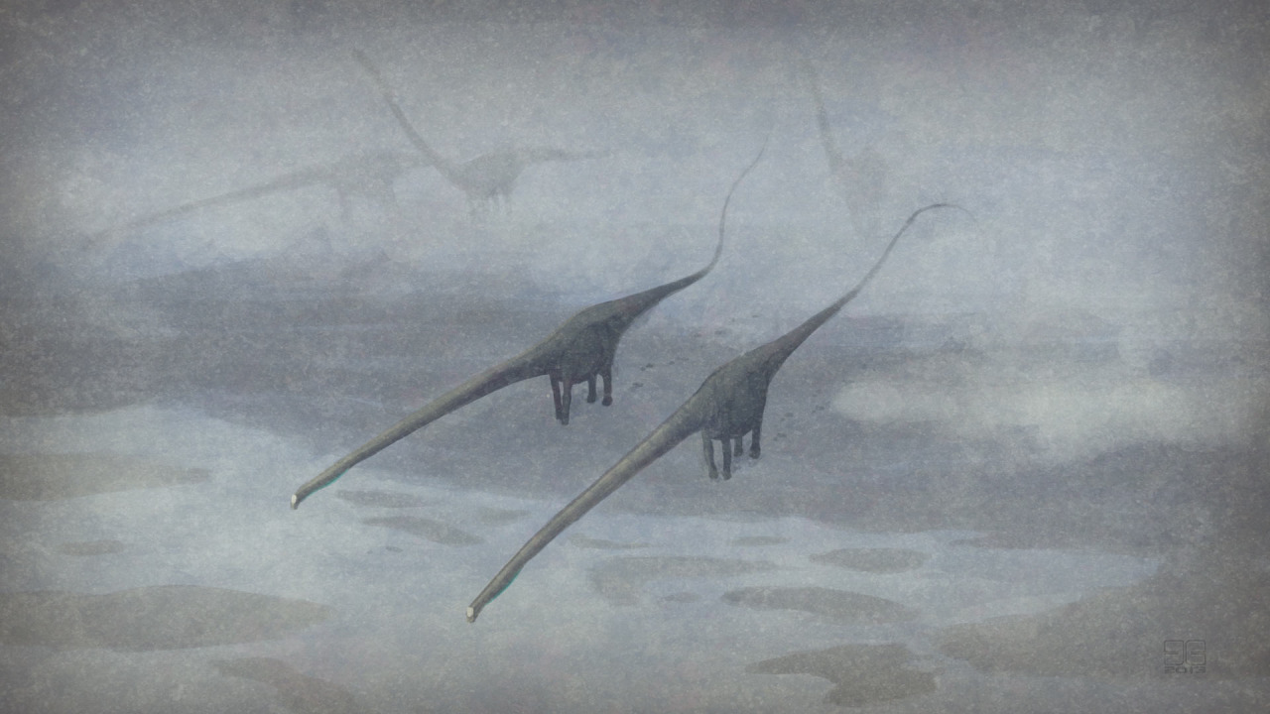
How big did Barosaurus get?
Michael P. Taylor
University of Bristol, UK.
dino@miketaylor.org.uk
Mathew J. Wedel
Western University of
Health Sciences
Pomona, California, USA.
mathew.wedel@gmail.com
Art by John Conway.
✓

Slide 2
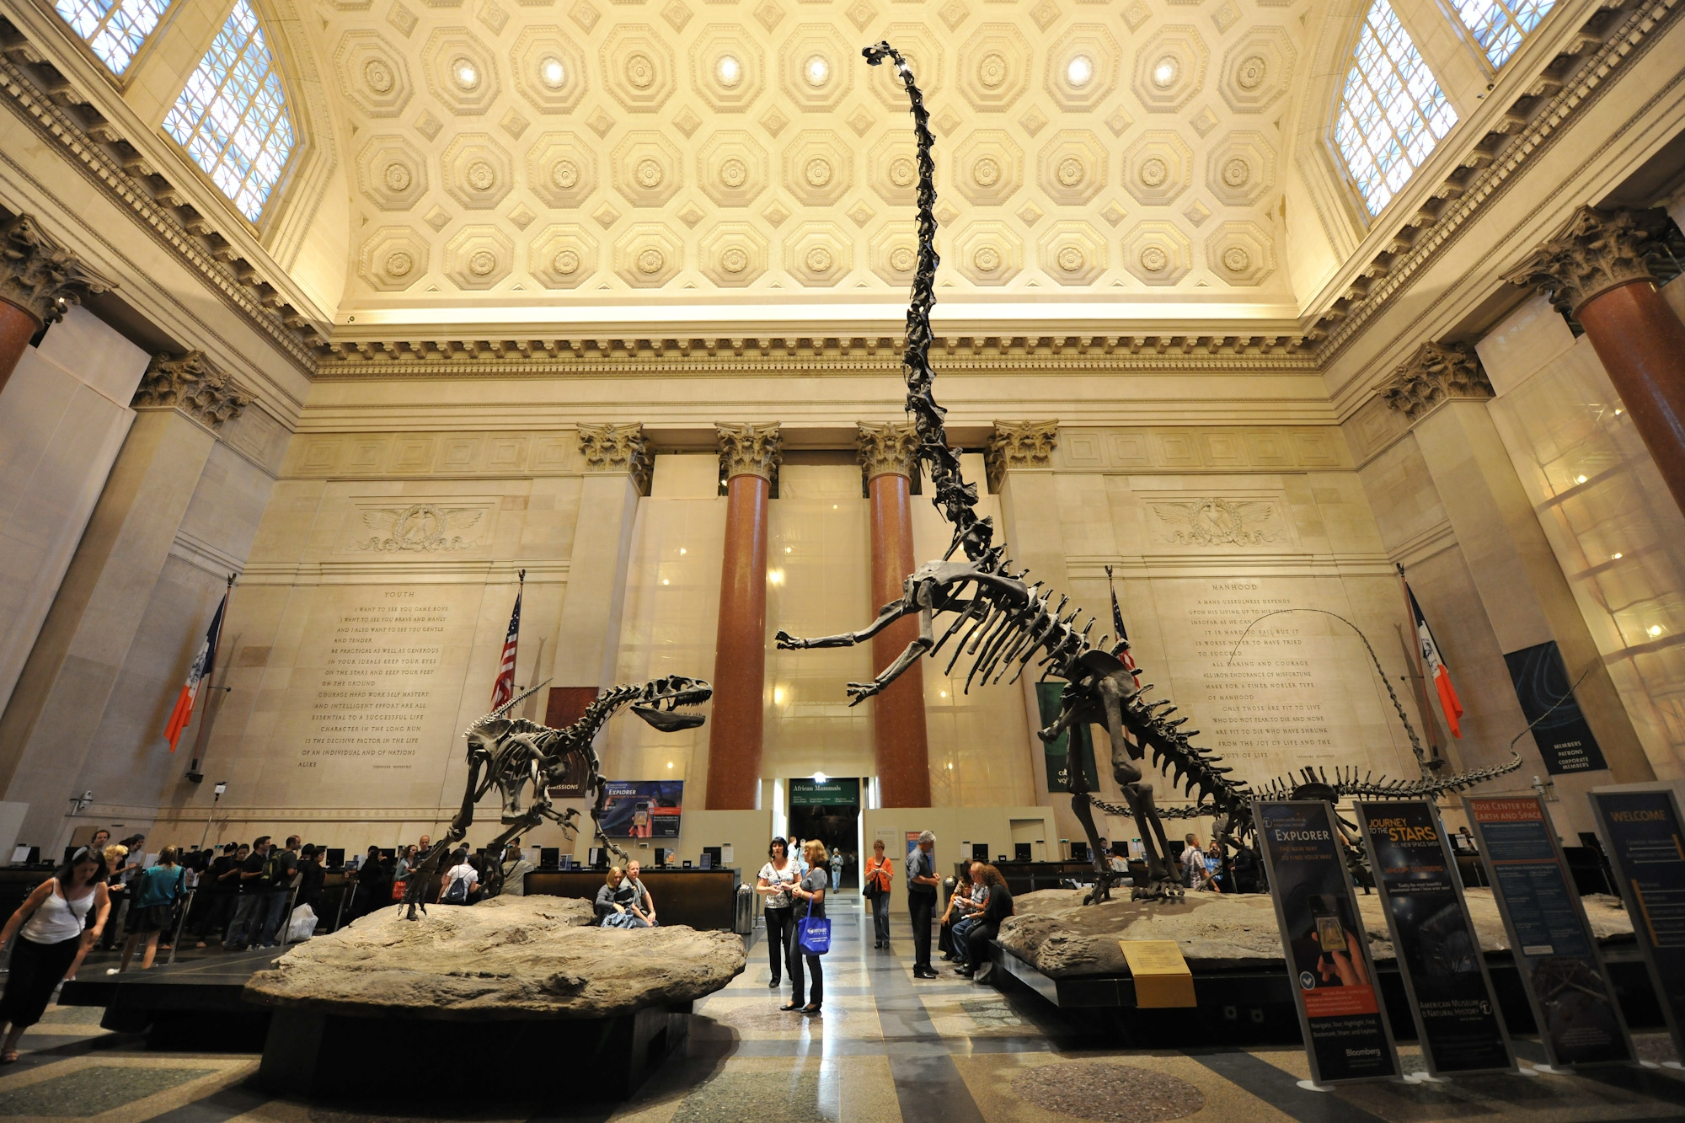
At the American Museum
of Natural History
At the American Museum
of Natural History

Slide 3
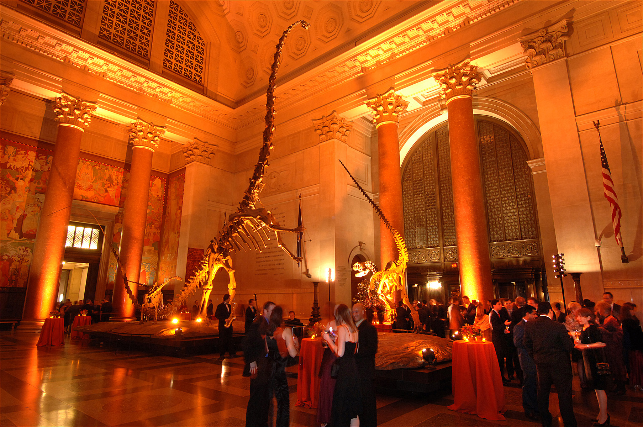
At the American Museum
of Natural History
At the American Museum
of Natural History

Slide 4
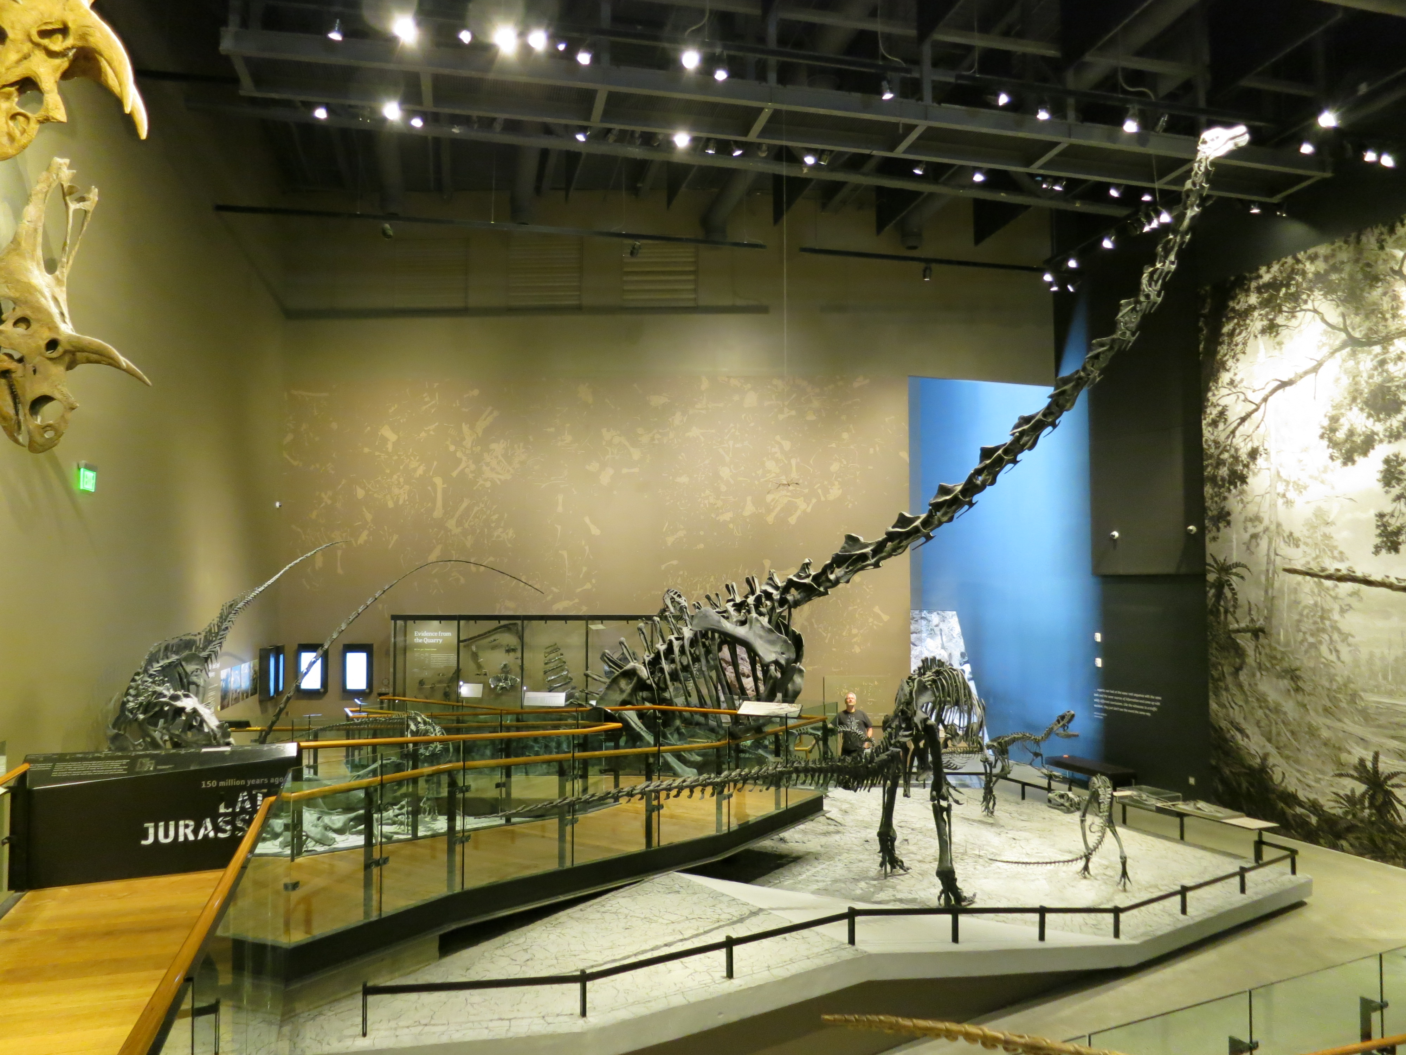
At the Utah Museum of Natural History
At the Utah Museum of Natural History

Slide 5
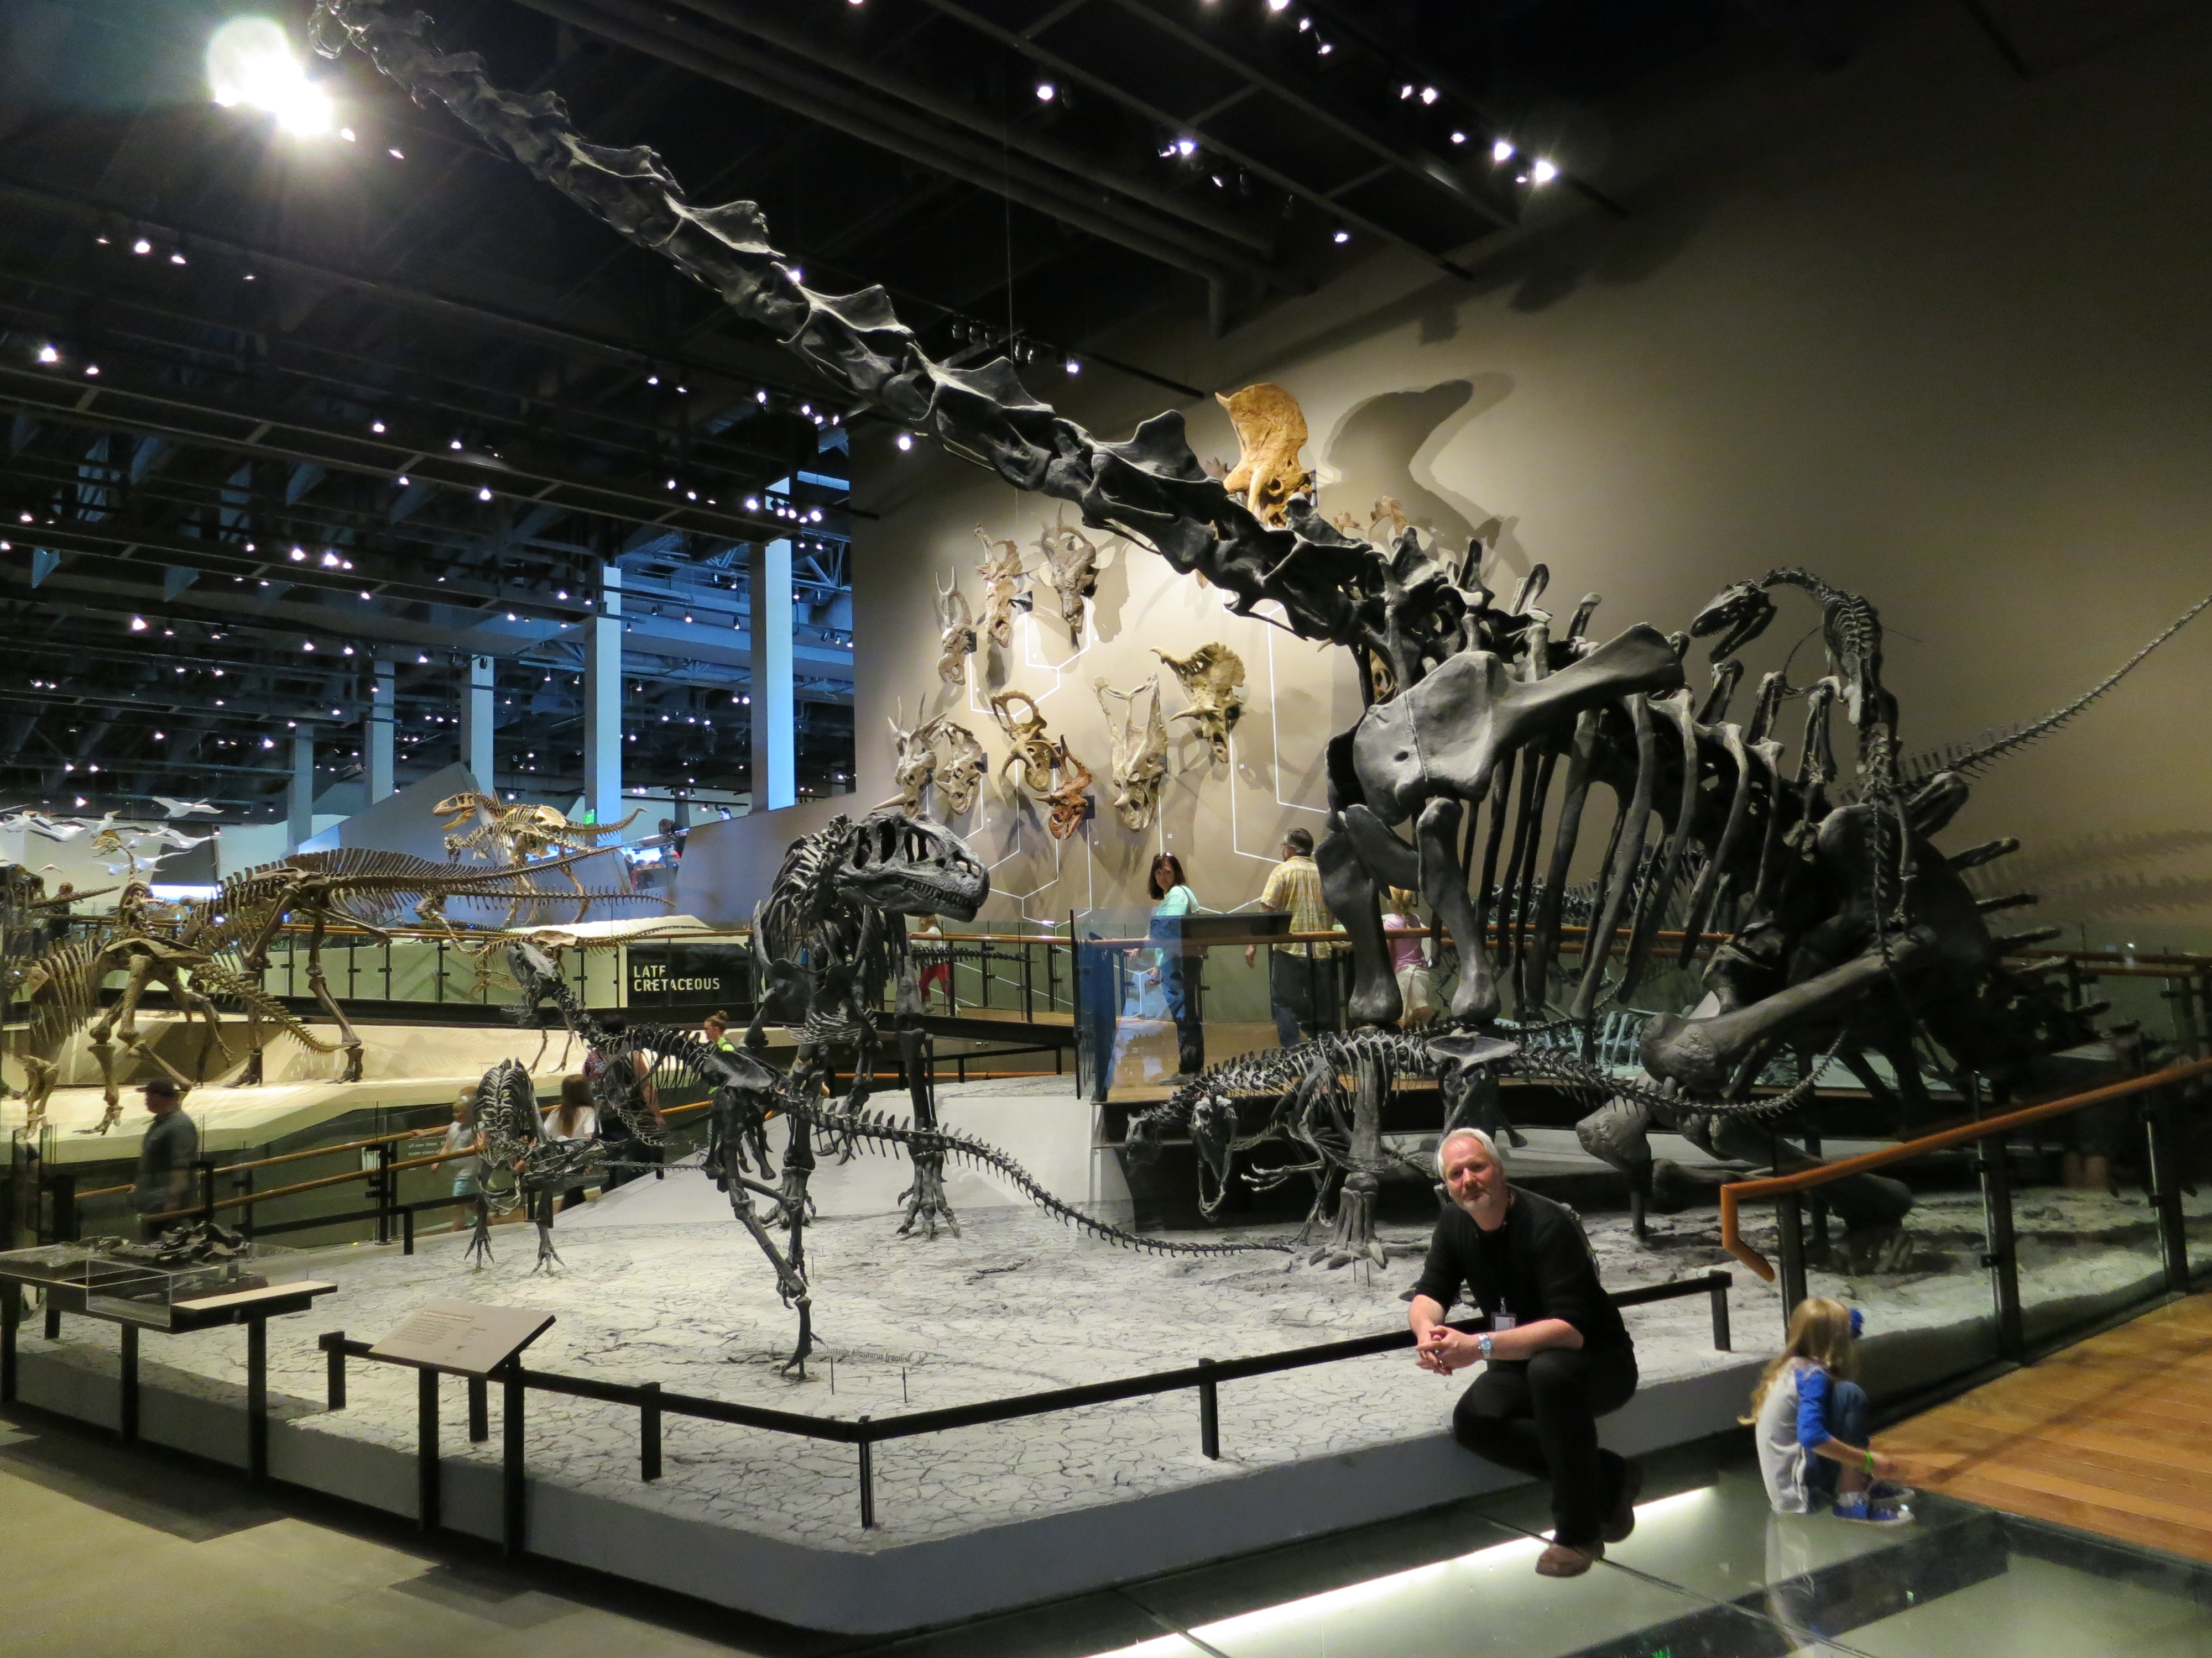
At the Utah Museum of Natural History
At the Utah Museum of Natural History

Slide 6
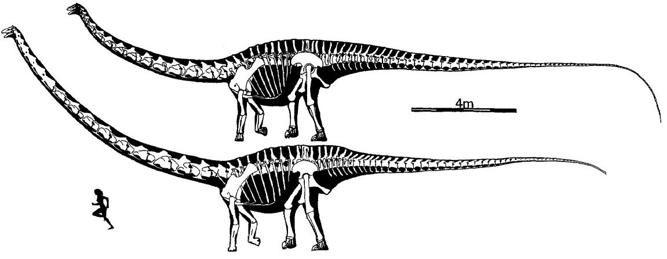
Barosaurus: longer neck than Diplodocus, otherwise broadly similar
Greg Paul, 1988

Slide 7
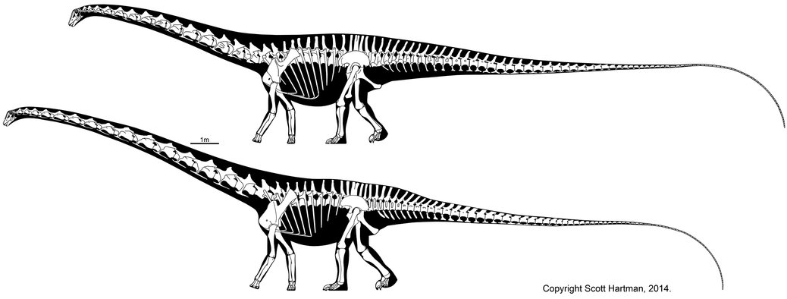
Barosaurus: longer neck than Diplodocus, otherwise broadly similar

Slide 8
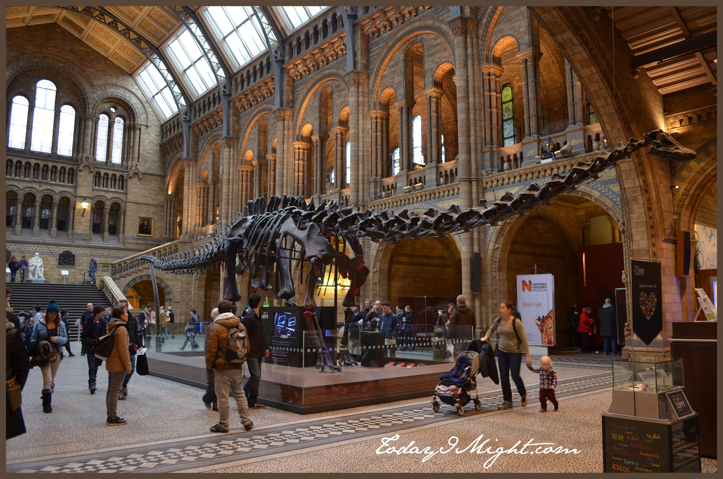
We all know what Diplodocus is like — disappointingly small
We all know what Diplodocus is like — disappointingly small

Slide 9
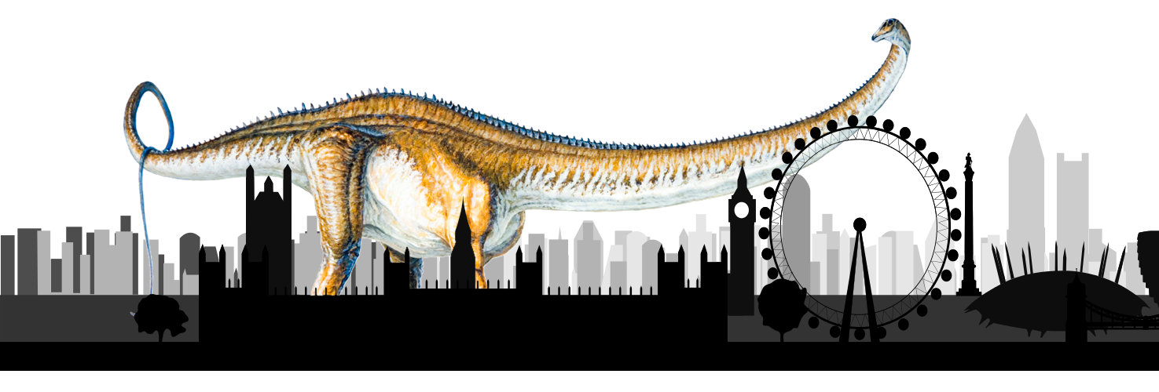
But did Barosaurus get really big?

Slide 10
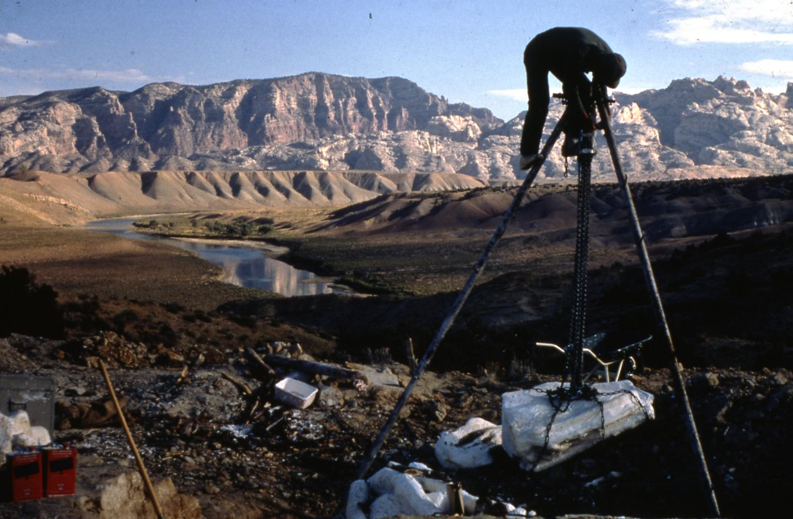
Jensen’s Jensen/Jensen quarry, Jensen

Slide 11
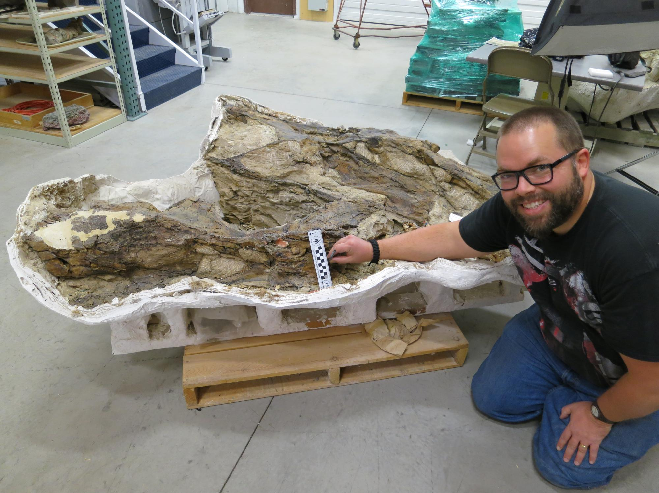
BYU field
jacket 3GR,
excavated
1966 from
Jensen/Jensen

Slide 12
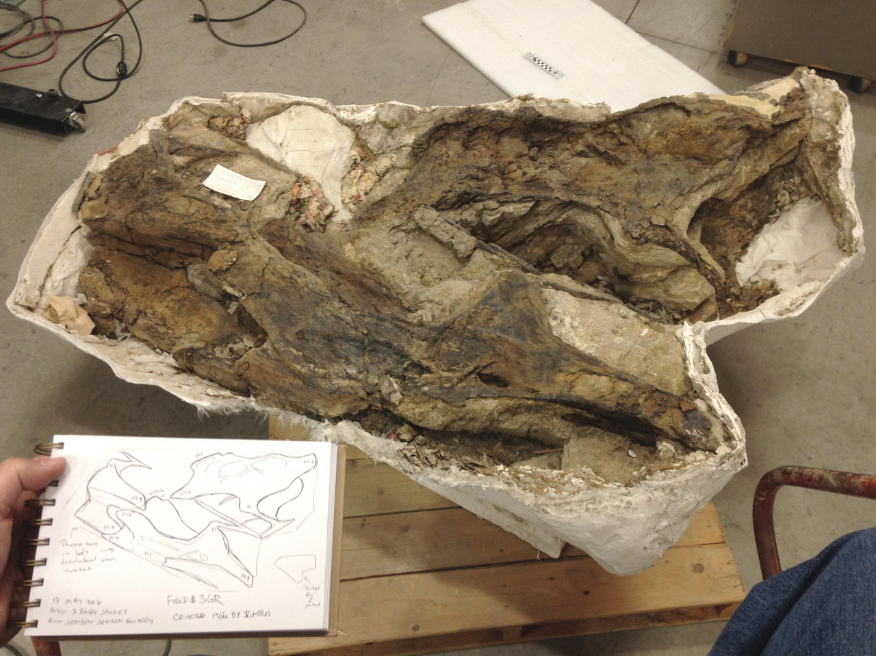
BYU field
jacket 3GR,
excavated
1966 from
Jensen/Jensen

Slide 13
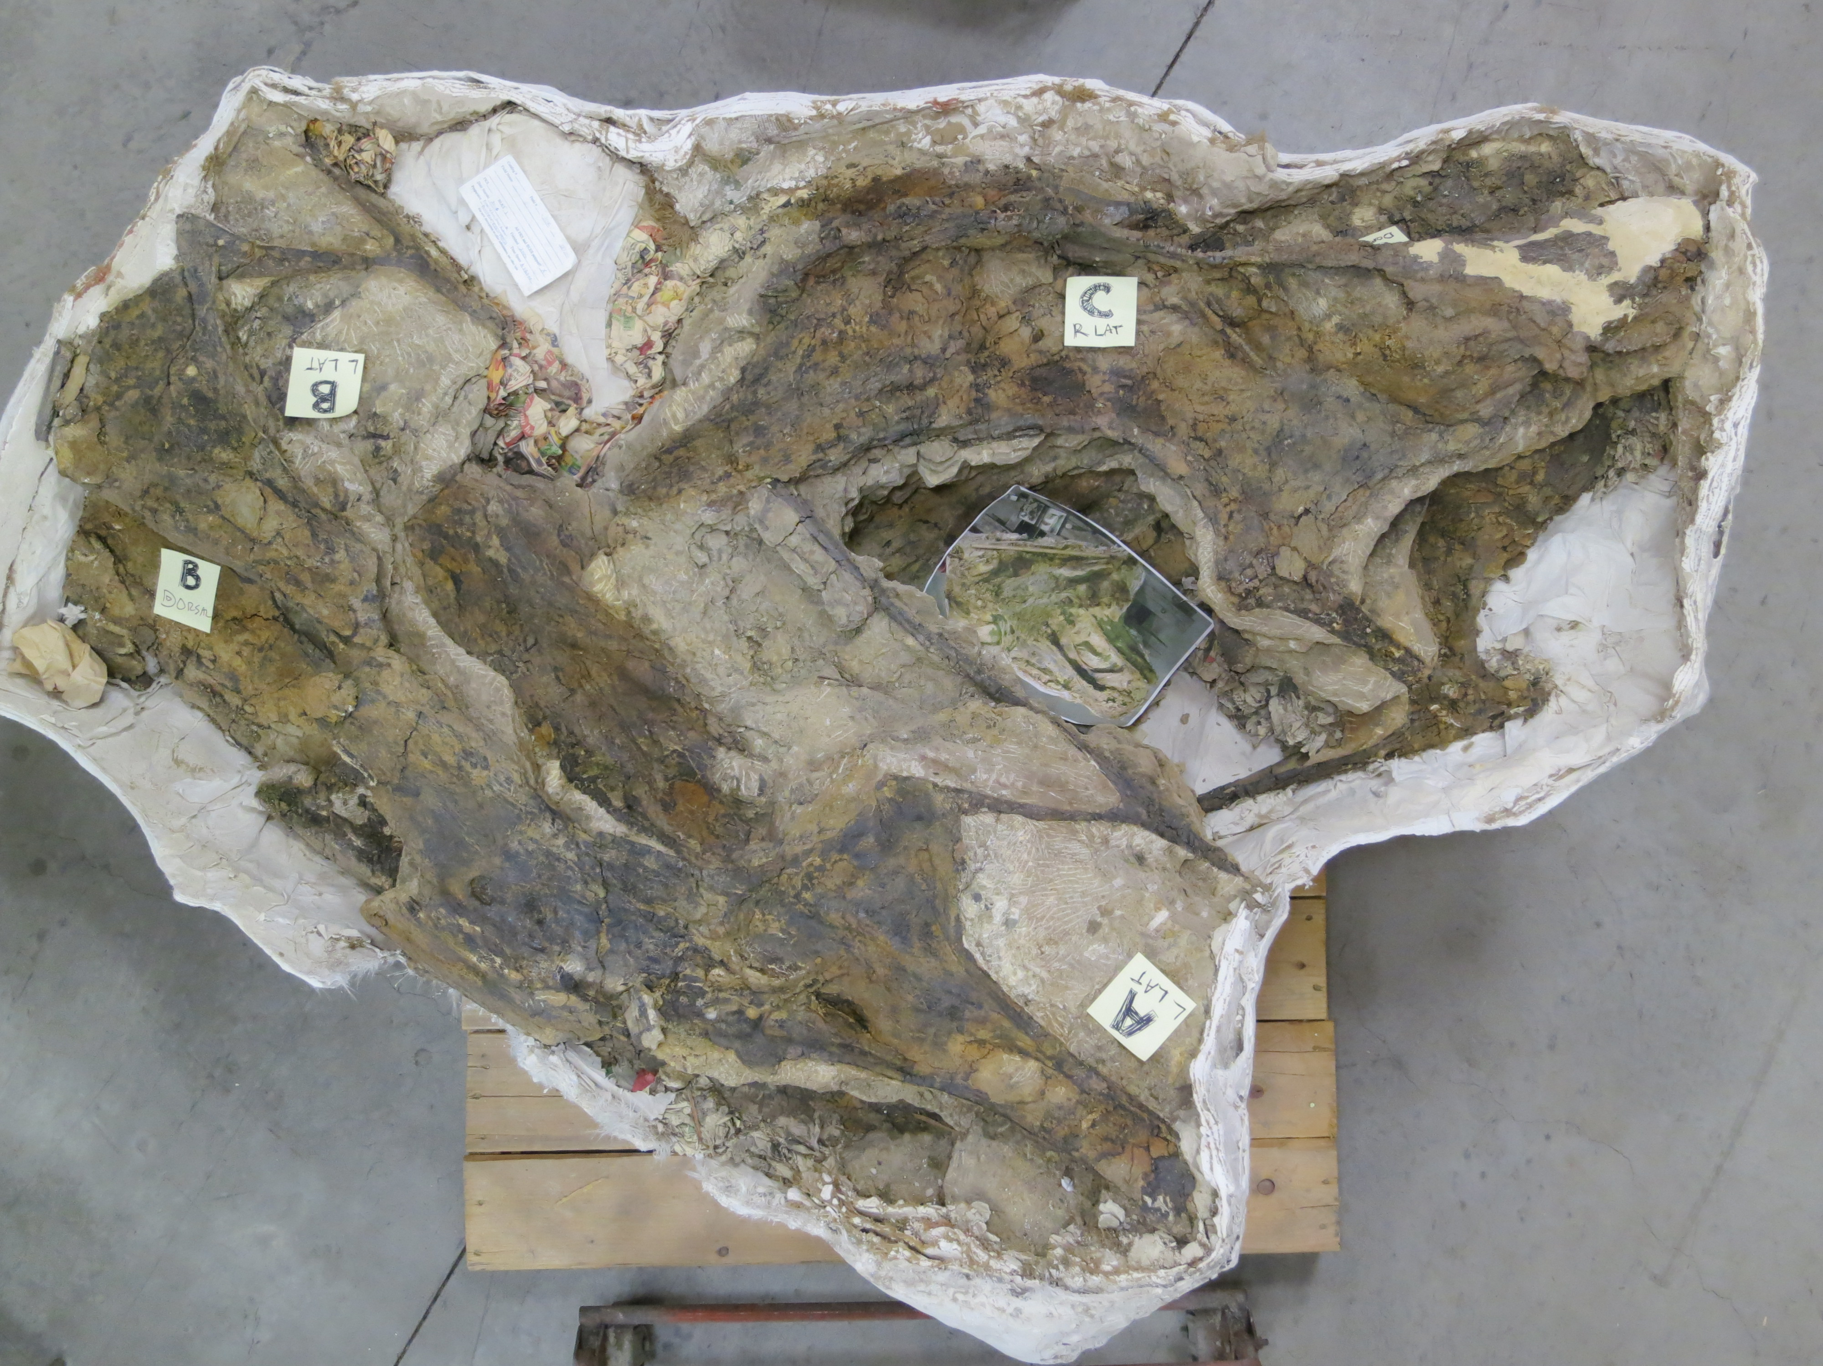
Contains three
?consecutive
Barosaurus
cervicals,
designated
A, B and C.
I00 cm

Slide 14
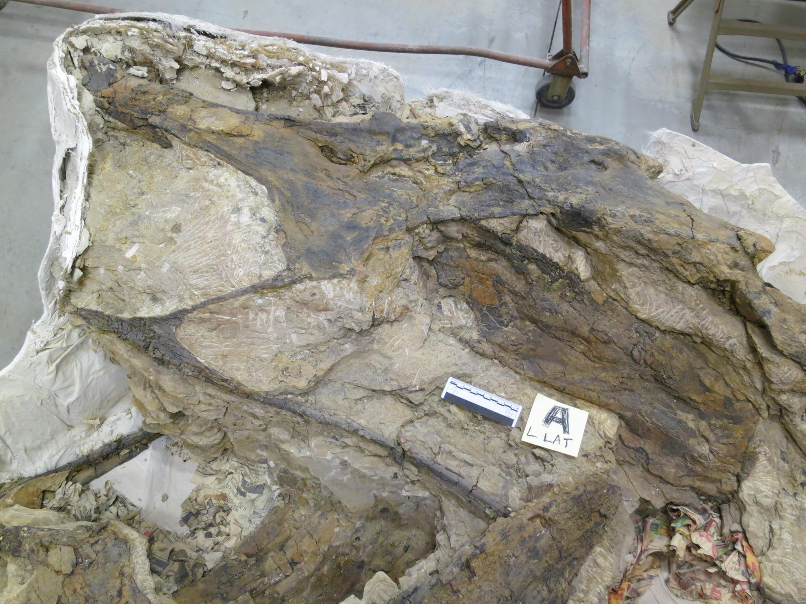
Barosaurus
cervical A,
left lateral

Slide 15
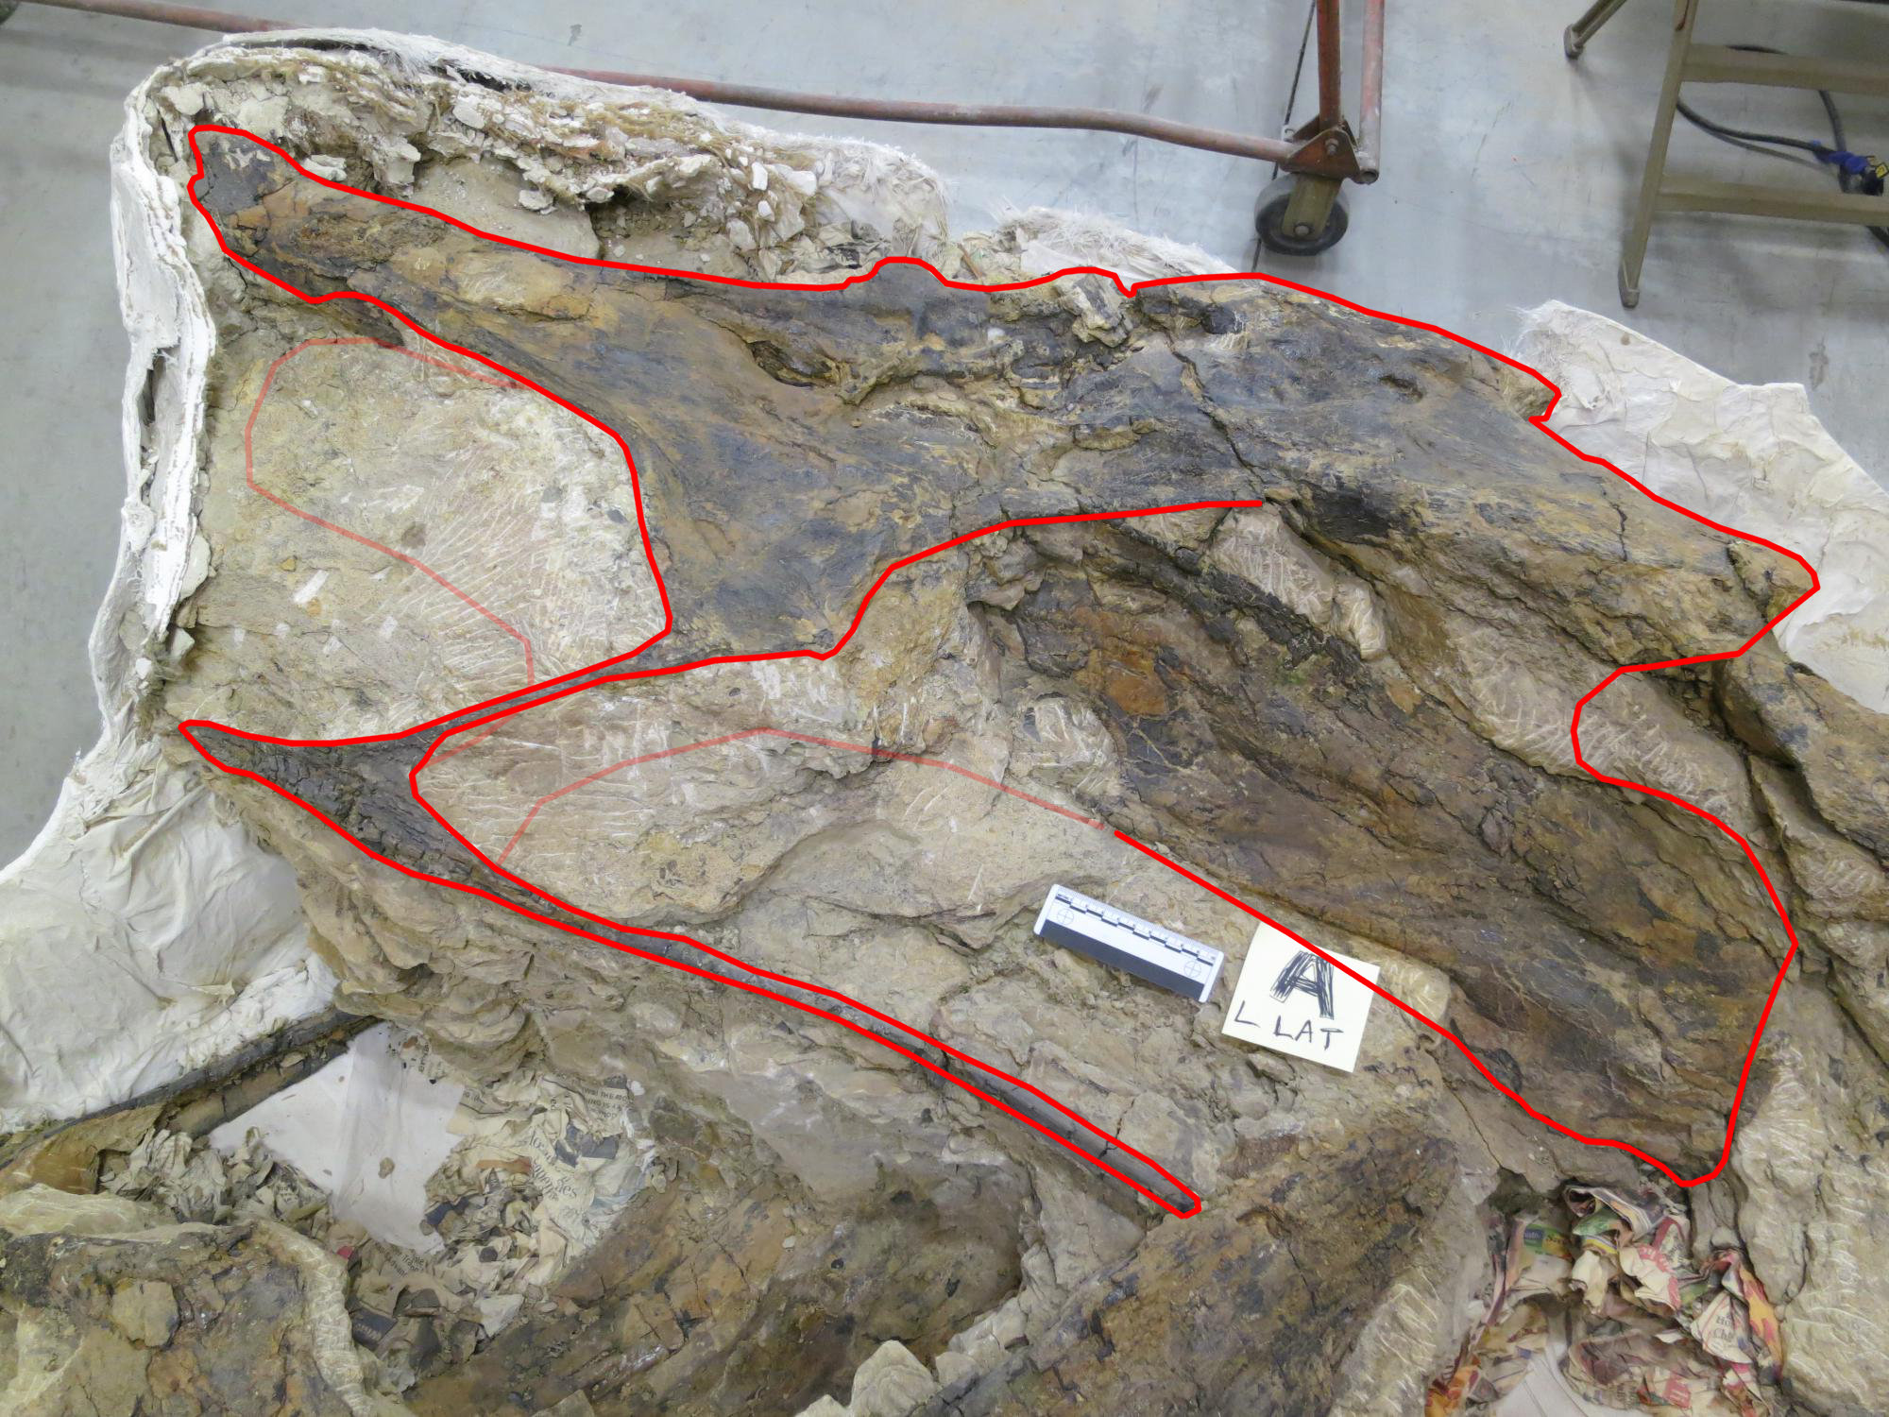
Barosaurus
cervical A,
left lateral

Slide 16
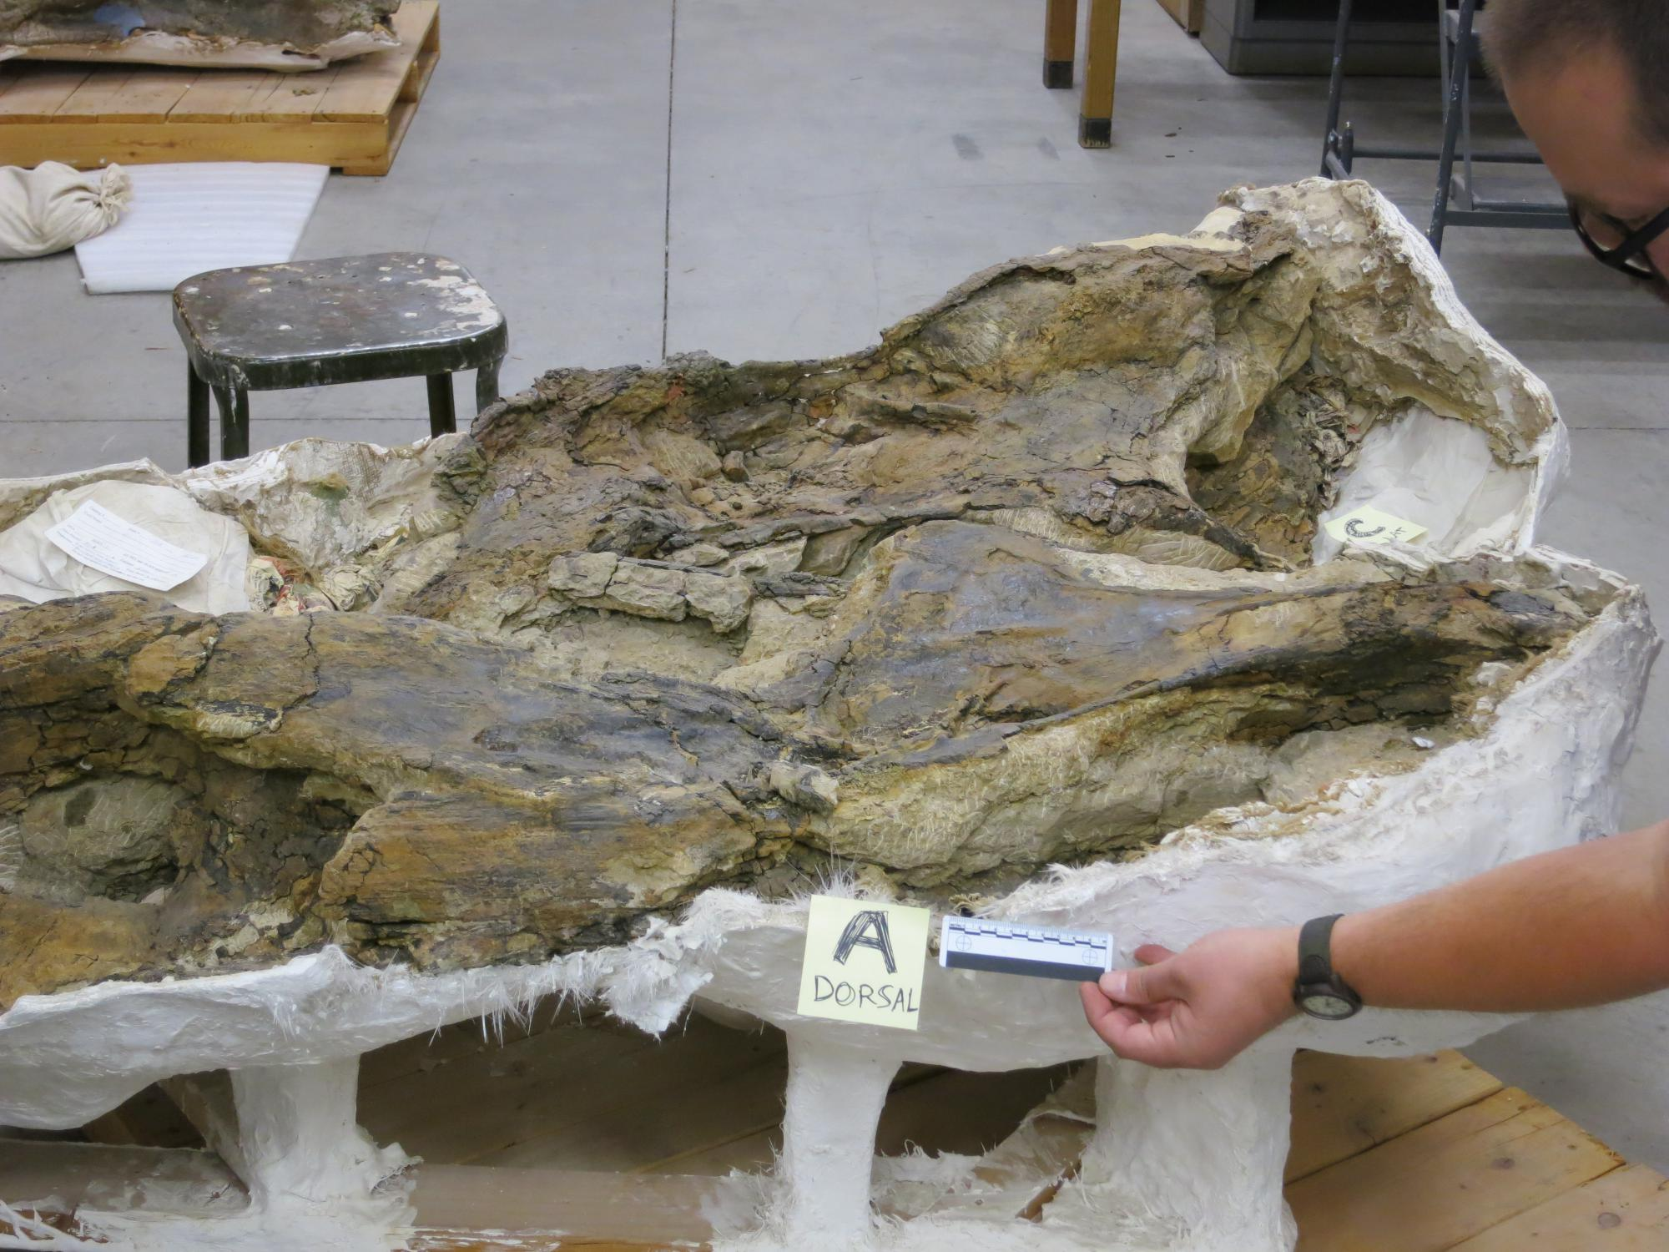
Barosaurus
cervical A,
dorsal view
(anterior to right)

Slide 17
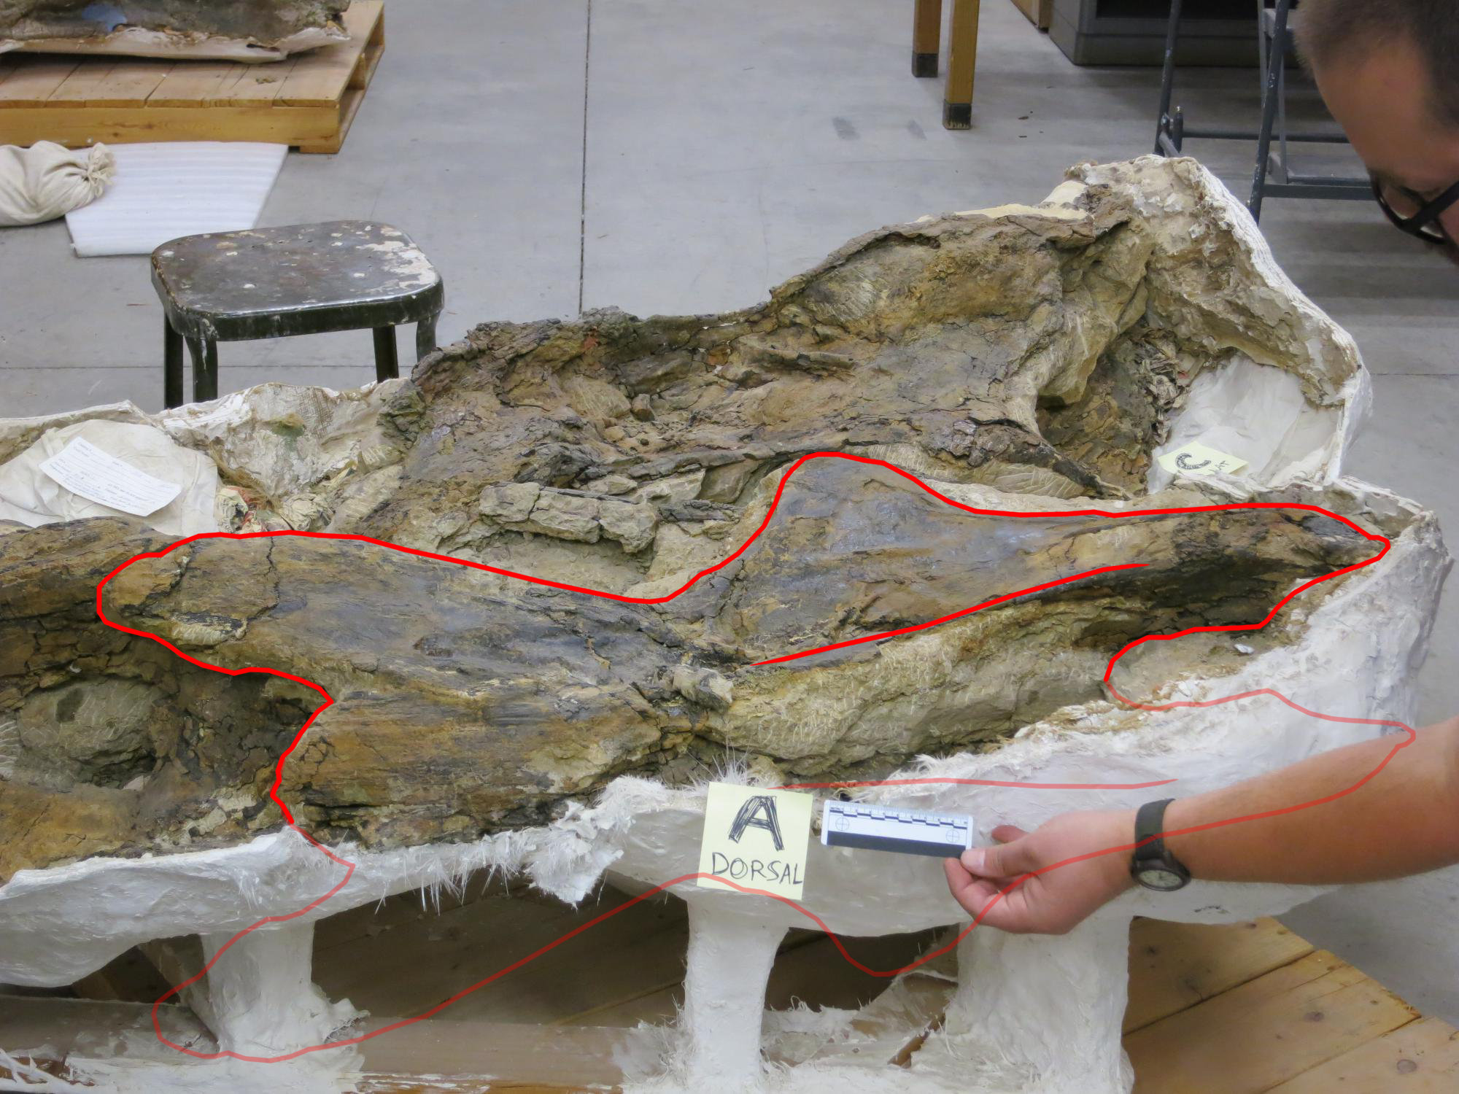
Barosaurus
cervical A,
dorsal view
(anterior to right)

Slide 18
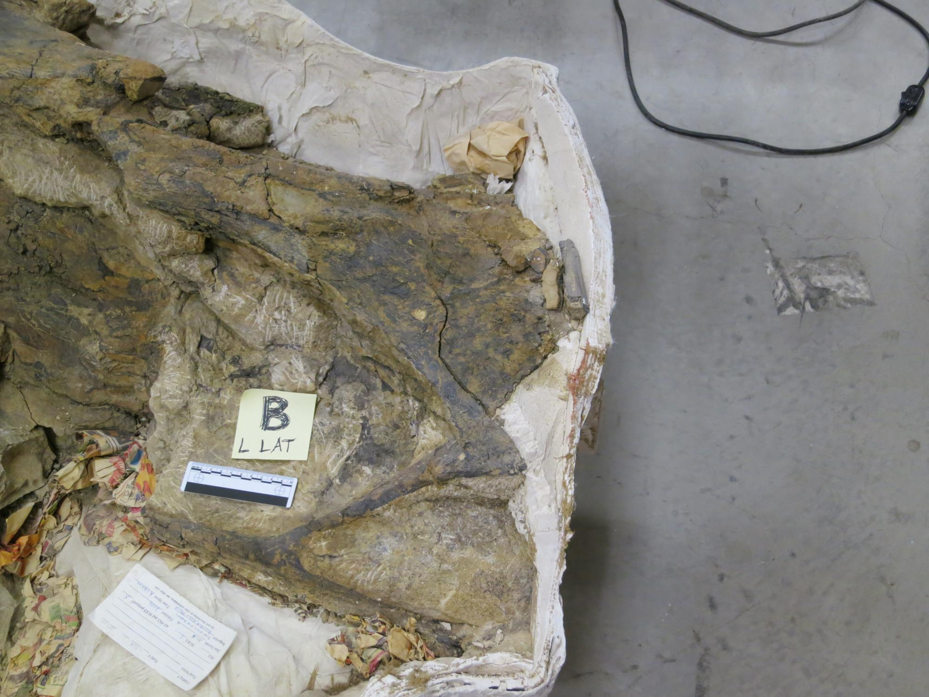
Barosaurus
cervical B,
left lateral

Slide 19
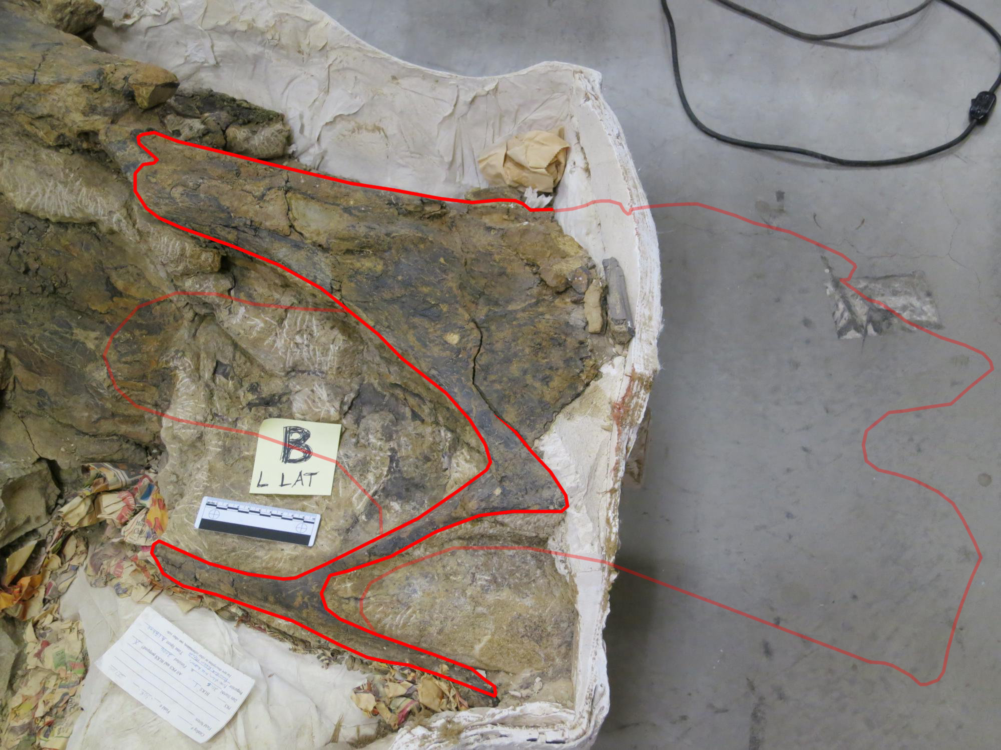
Barosaurus
cervical B,
left lateral

Slide 20
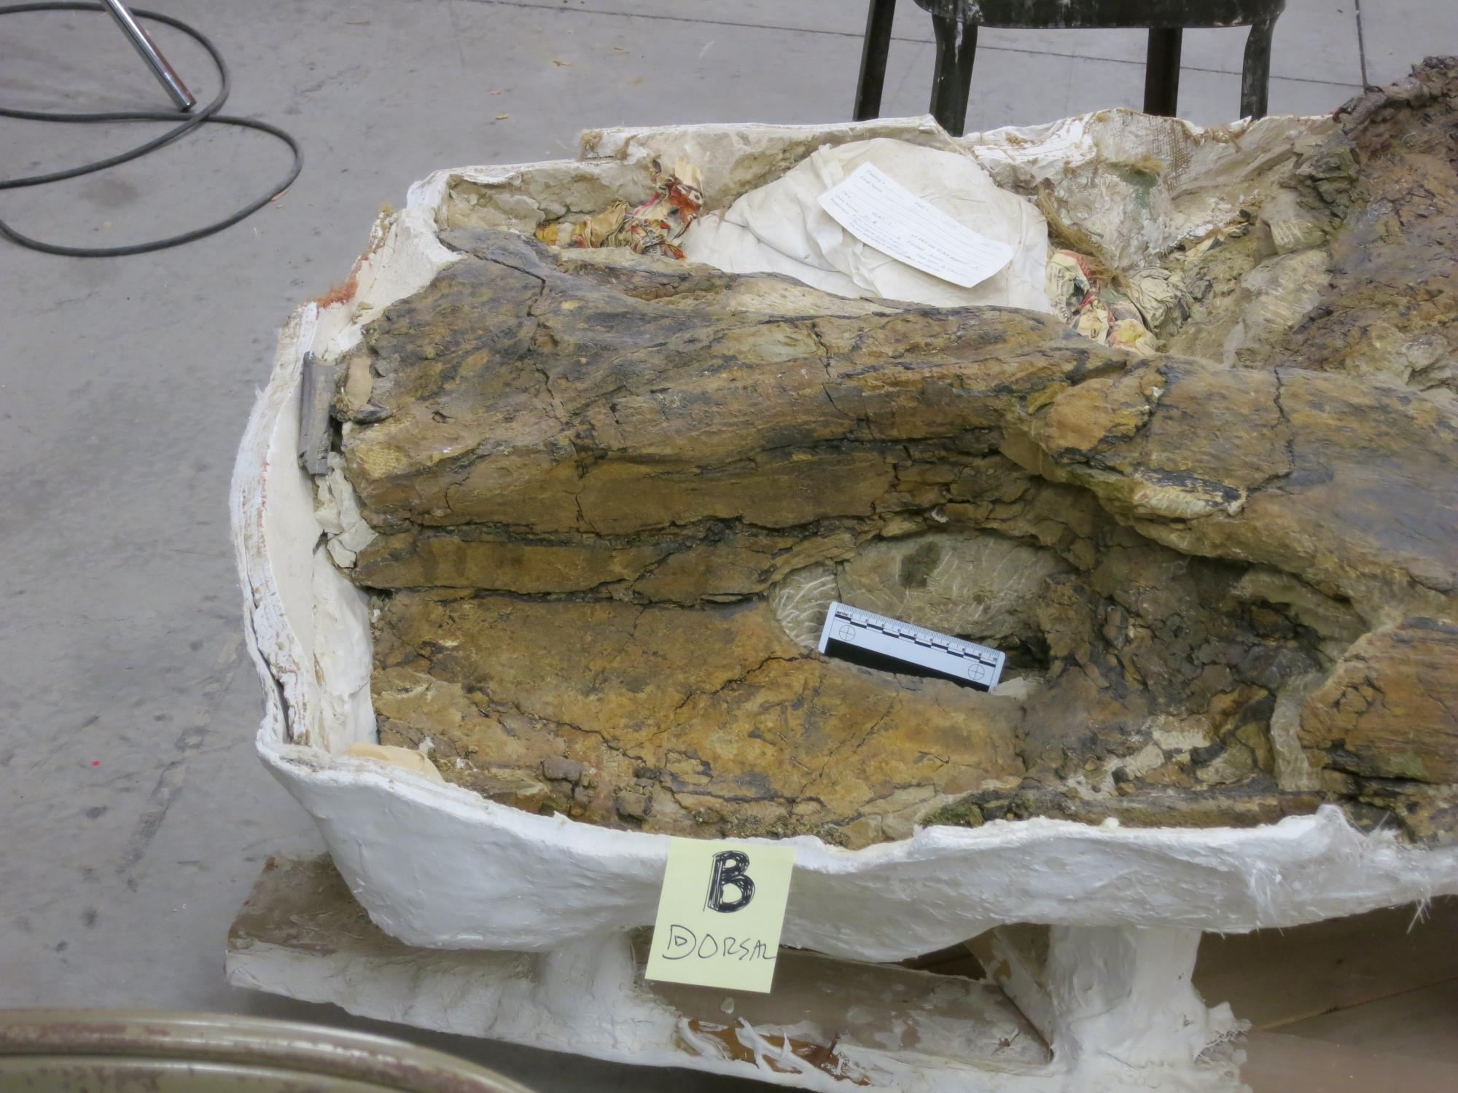
Barosaurus
cervical B,
dorsal view
(anterior to right)

Slide 21
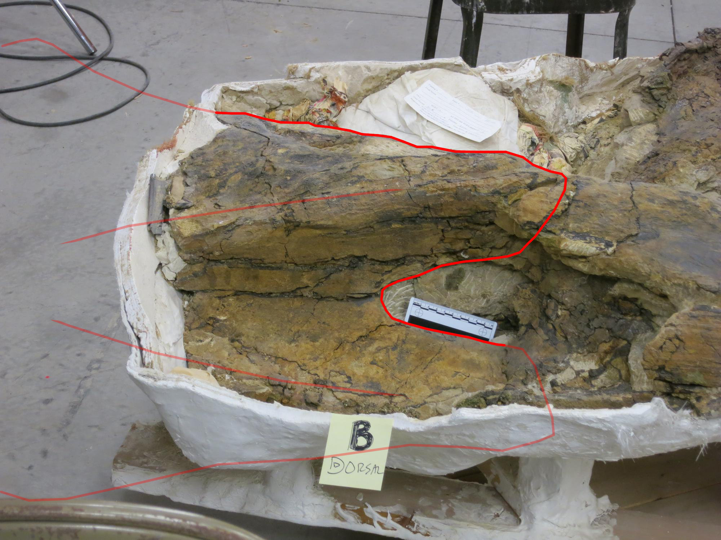
Barosaurus
cervical B,
dorsal view
(anterior to right)

Slide 22
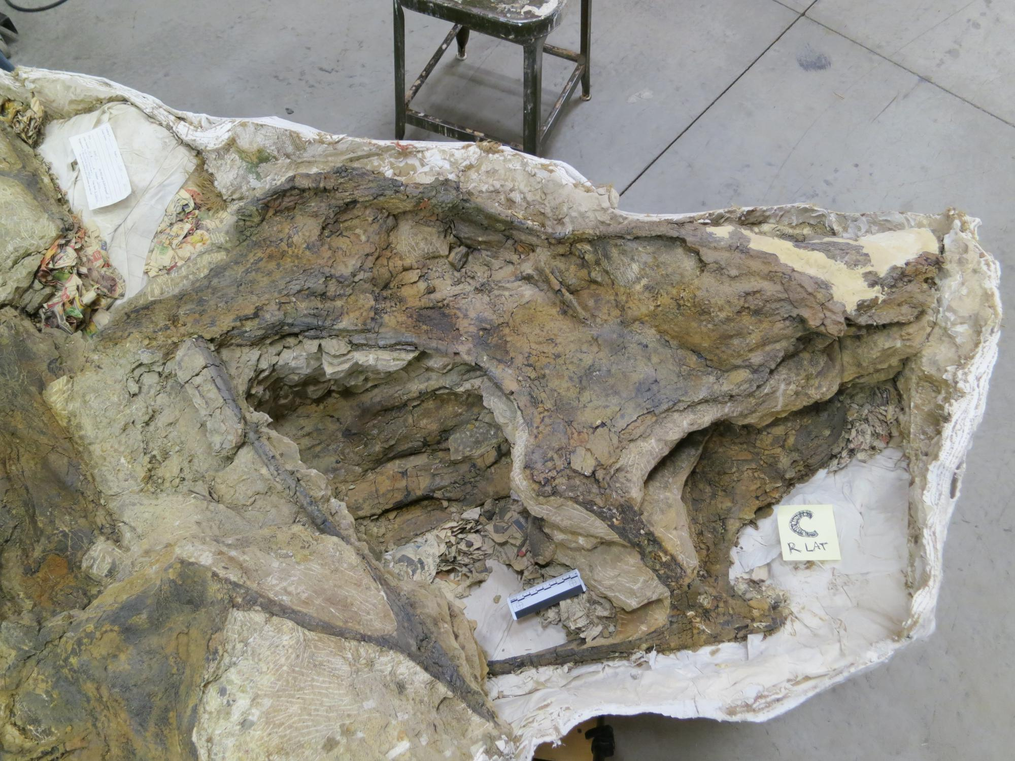
Barosaurus
cervical C,
right lateral

Slide 23
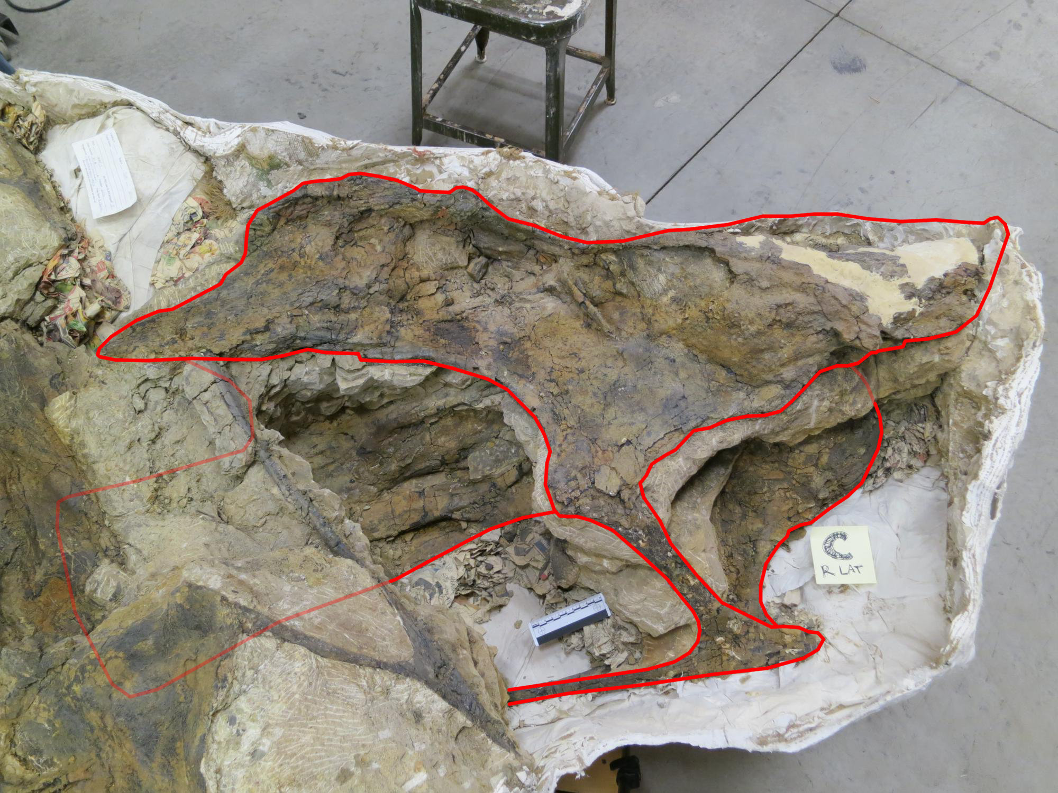
Barosaurus
cervical C,
right lateral

Slide 24
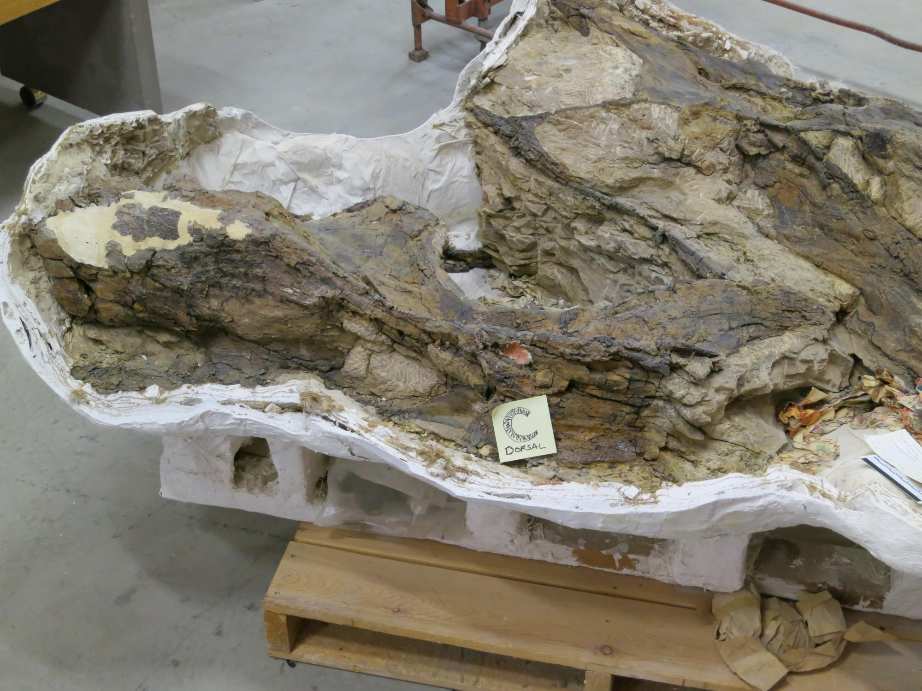
Barosaurus
cervical C,
dorsal view
(anterior to left)

Slide 25
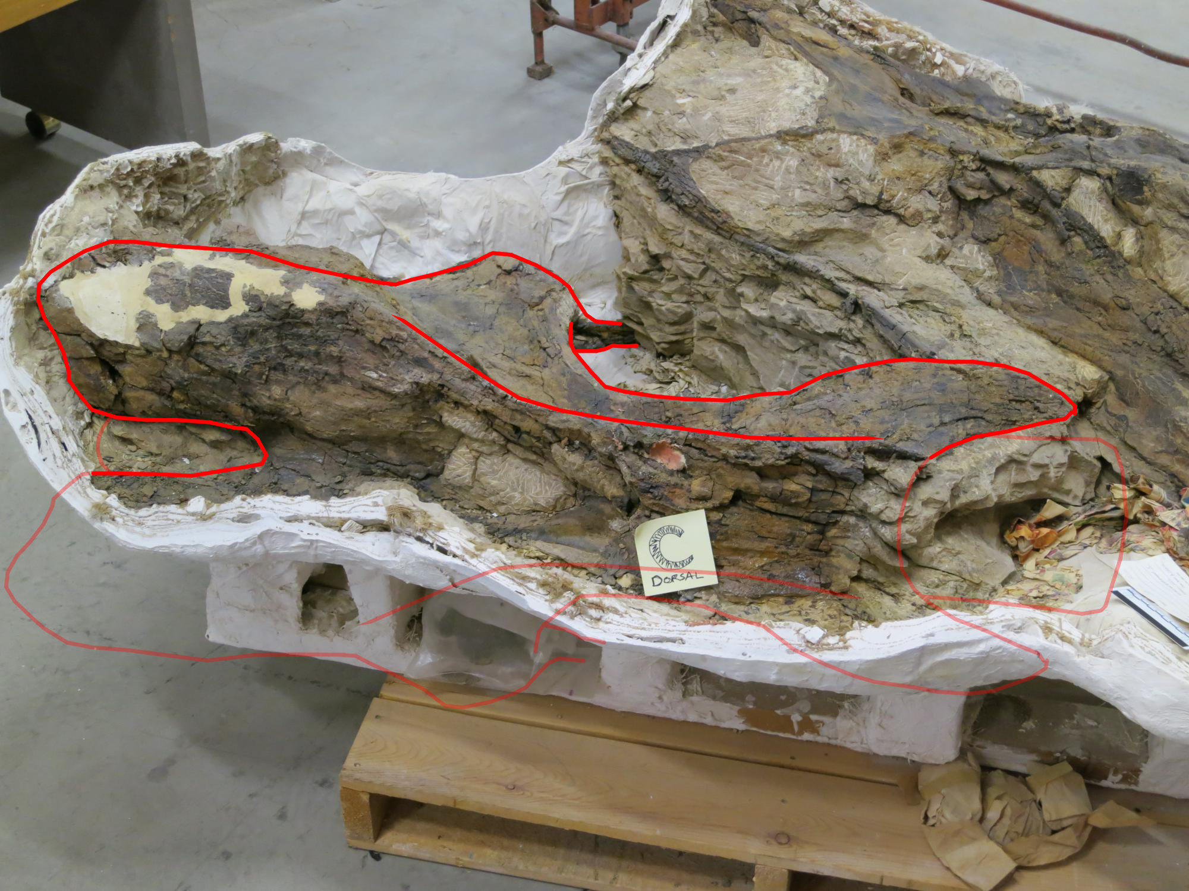
Barosaurus
cervical C,
dorsal view
(anterior to left)

Slide 26
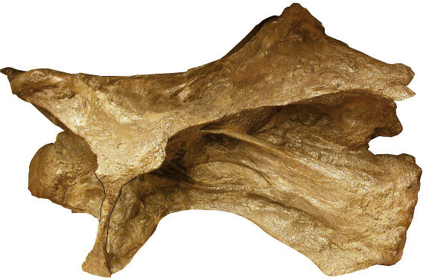
Why do we think
this is Barosaurus?

Slide 27
Barosaurus
cervical A,
left lateral

Slide 28
Barosaurus
cervical A,
left lateral

Slide 29
Barosaurus
cervical A,
left lateral

Slide 30
Barosaurus
cervical A,
left lateral

Slide 31
Barosaurus
cervical A,
left lateral

Slide 32
Barosaurus
cervical A,
left lateral

Slide 33
Barosaurus
cervical B,
left lateral

Slide 34
Barosaurus
cervical B,
left lateral

Slide 35
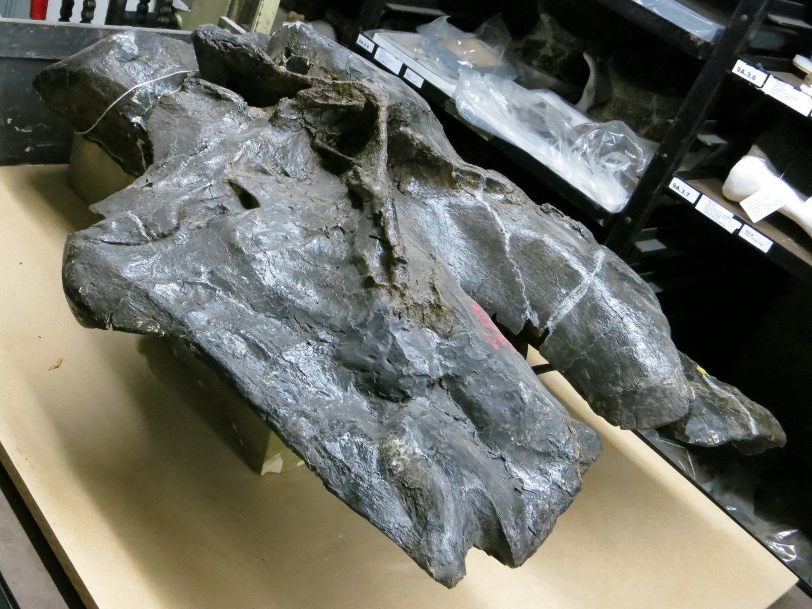
Barosaurus
Holotype
YPM 429,
Cervical R
“thumb
groove”

Slide 36
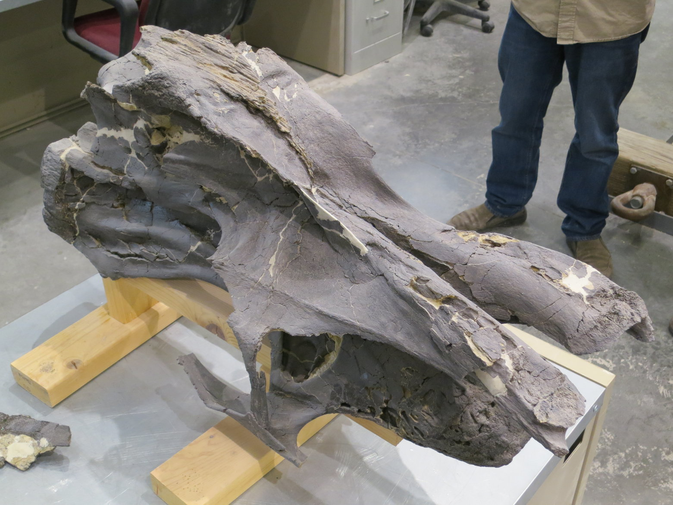
Barosaurus
nice example
of thumb-slot.
Privately owned
specimen at
NAMAL …
Access courtesy
Western Paleo Labs

Slide 37
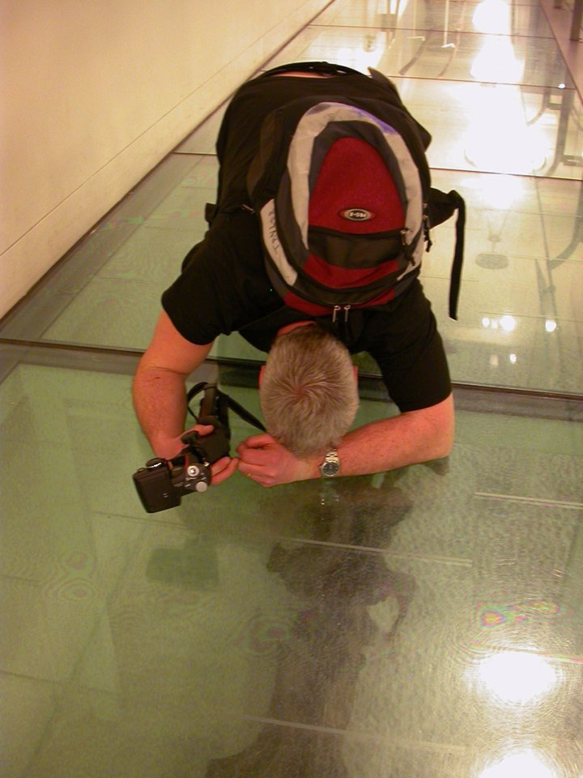
Privately owned
specimen at
NAMAL …
… Not like the nice specimen at AMNH which is always available to researchers.

Slide 38
Barosaurus
cervical B,
dorsal view
(anterior to right)

Slide 39
Barosaurus
cervical B,
dorsal view
(anterior to right)

Slide 40
Barosaurus
cervical B,
dorsal view
(anterior to right)

Slide 41
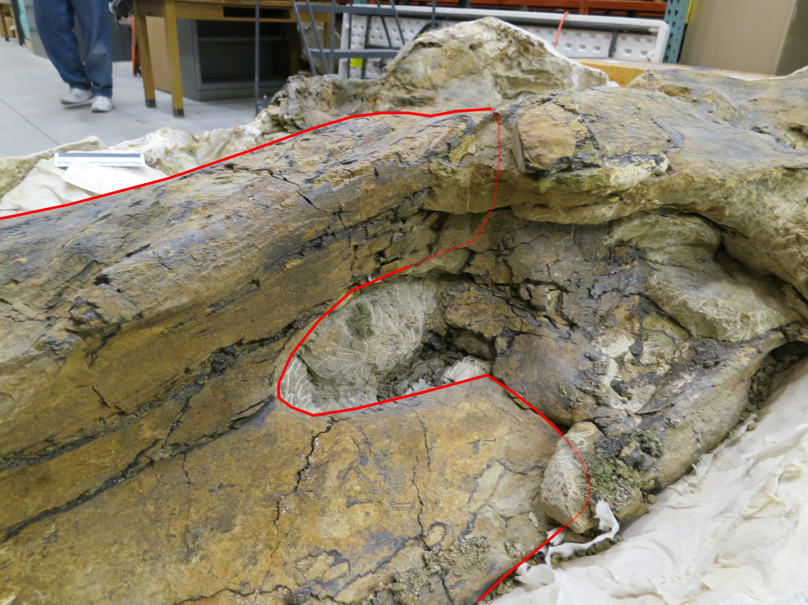
Barosaurus
cervical B,
dorsal view
(anterior to right)
Becomes PRDL
Becomes SPRL

Slide 42
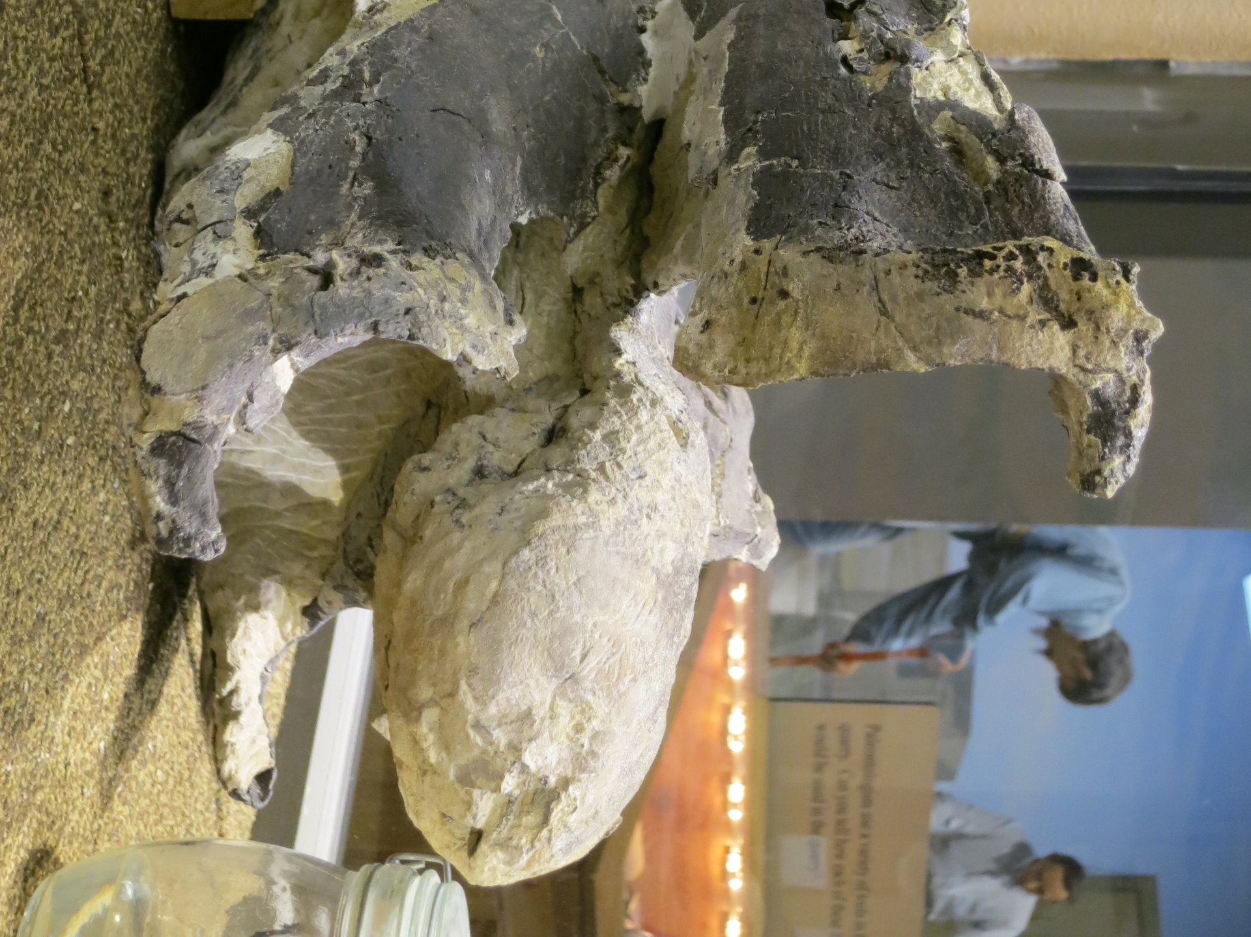
Barosaurus
nice example
of “hinges”.
Privately owned
specimen at
NAMAL.
Access courtesy
Western Paleo Labs

Slide 43
Barosaurus
cervical C,
right lateral

Slide 44
Barosaurus
cervical C,
right lateral

Slide 45
Barosaurus
cervical C,
dorsal view
(anterior to left)

Slide 46
Barosaurus
cervical C,
dorsal view
(anterior to left)

Slide 47
Barosaurus
cervical C,
dorsal view
(anterior to left)

Slide 48
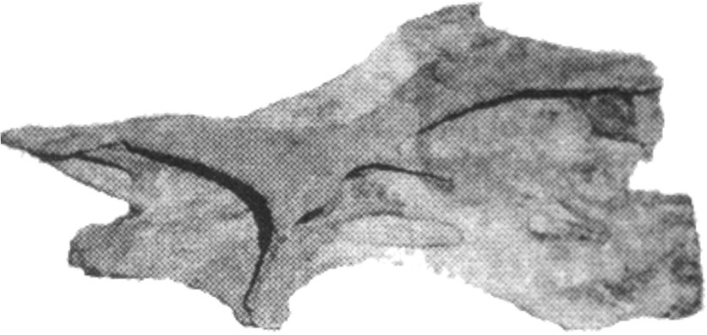
Cervical C is probably C9
based on proportions and
spine bifurcation.
But could be C10 or C11.

Slide 49
How long are these bones?
Cervical A
prezyg to postzyg: 102 cm
prezyg to cotyle: 108 cm
=> postzyg to cotyle: 6 cm

Slide 50
How long are these bones?
Cervical A
prezyg to postzyg: 102 cm
prezyg to cotyle: 108 cm
=> postzyg to cotyle: 6 cm
Cervical C
condyle to postzyg: 104 cm

Slide 51
How long are these bones?
Cervical A
prezyg to postzyg: 102 cm
prezyg to cotyle: 108 cm
=> postzyg to cotyle: 6 cm
Cervical C
condyle to postzyg: 104 cm
=> condyle to cotyle: 104 + 6 = 110 cm — in the Top Five

Slide 52
AMNH centra:
C9: 685 mm
C10: 737 mm
C11: 777 mm
Cervical C centrum:
1100 mm (est.)
1.61 × C9
1.49 × C10
1.42 × C11

Slide 53
Based on 8.5 m for AMNH, suggests a neck 12.07-13.69 m long
AMNH 6341

Slide 54
Based on 8.5 m for AMNH, suggests a neck 12.07-13.69 m long
AMNH 6341
}
Range for
BYU 3GR

Slide 55
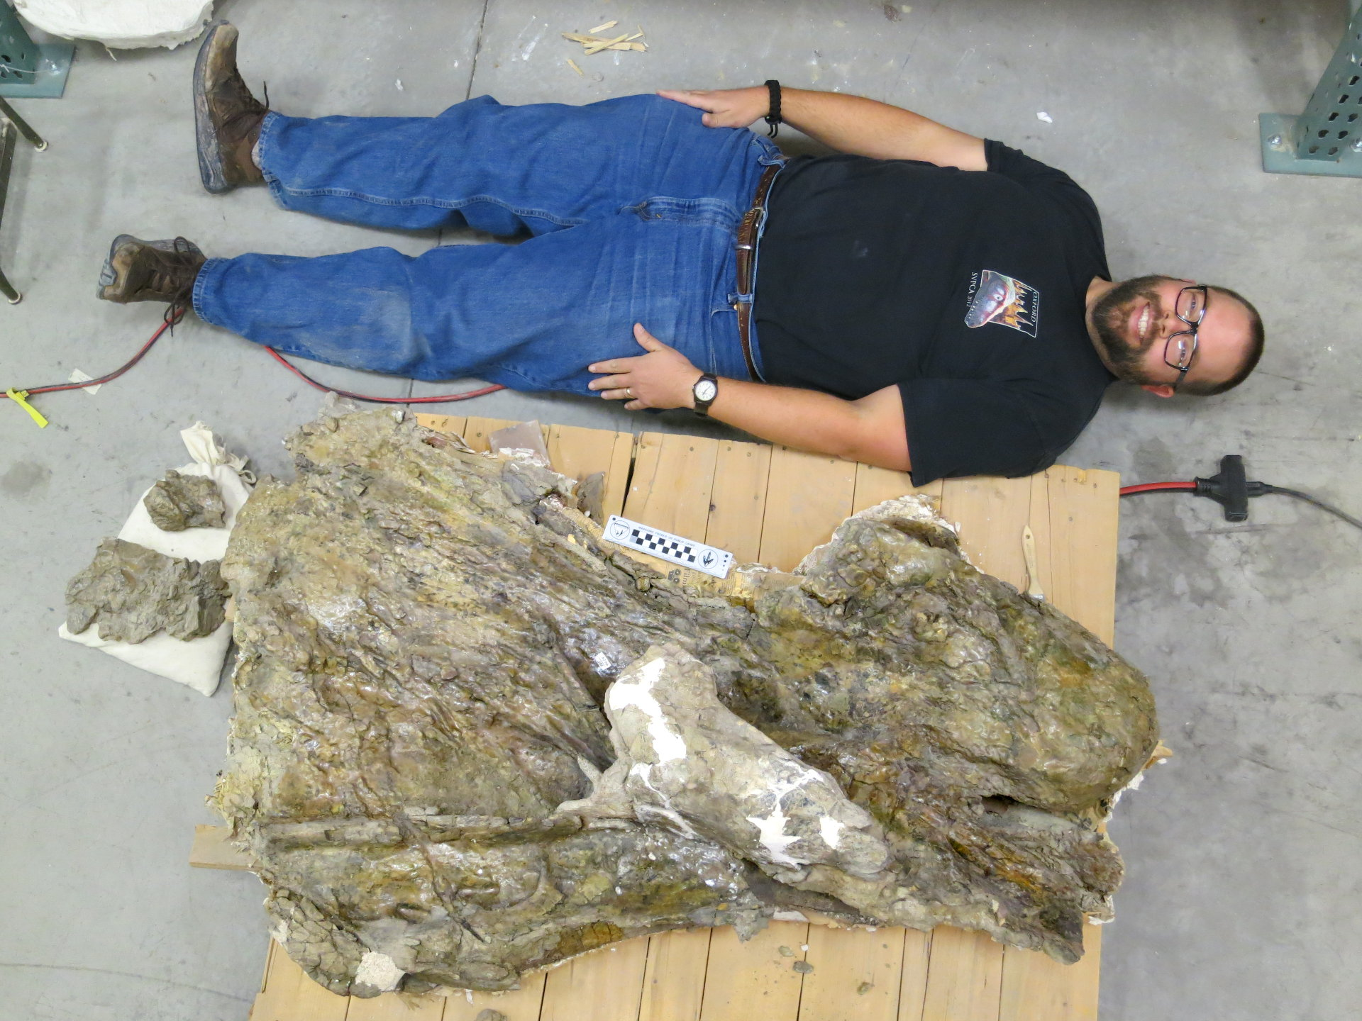
BYU 9024
“Supersaurus”
Cervical
“It's incredible that a beast
that size could support its
own weight.”

Slide 56
BYU 9024
“Supersaurus”
Cervical
“It's incredible that a beast
that size could support its
own weight.”
“Yes, and the Supersaurus
vertebra was from an even
bigger animal.”

Slide 57
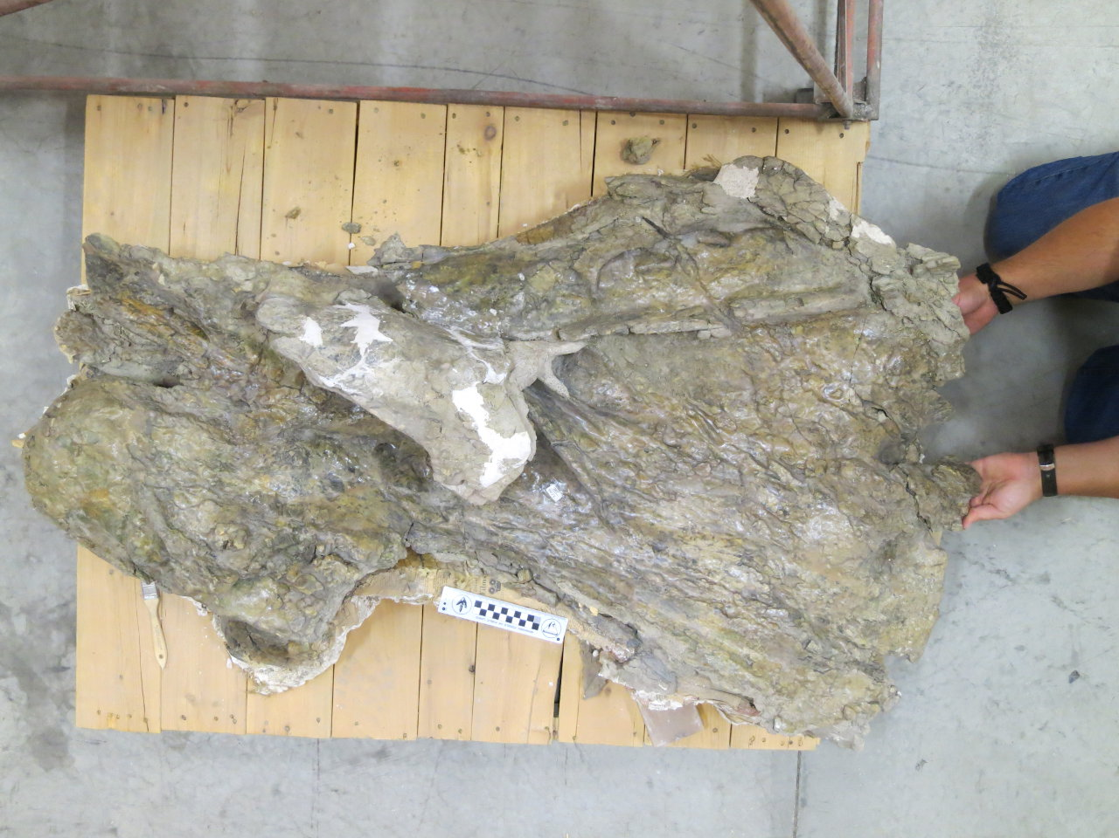
BYU 9024
“Supersaurus”
Cervical
Left lateral.
Postzyg and
PODL folded
upwards.
100 cm

Slide 58
BYU 9024
“Supersaurus”
Cervical
Left lateral.
We think
it's Barosaurus!

Slide 59
BYU 9024
“Supersaurus”
Cervical
Left lateral.
We think
it's Barosaurus!

Slide 60
BYU 9024
“Supersaurus”
Cervical
Left lateral.
We think
it's Barosaurus!

Slide 61
BYU 9024
“Supersaurus”
Cervical
Left lateral.
We think
it's Barosaurus!

Slide 62
BYU 9024
“Supersaurus”
Cervical
Left lateral.
We think
it's Barosaurus!

Slide 63
BYU 9024
“Supersaurus”
Cervical
Left lateral.
We think
it's Barosaurus!

Slide 64
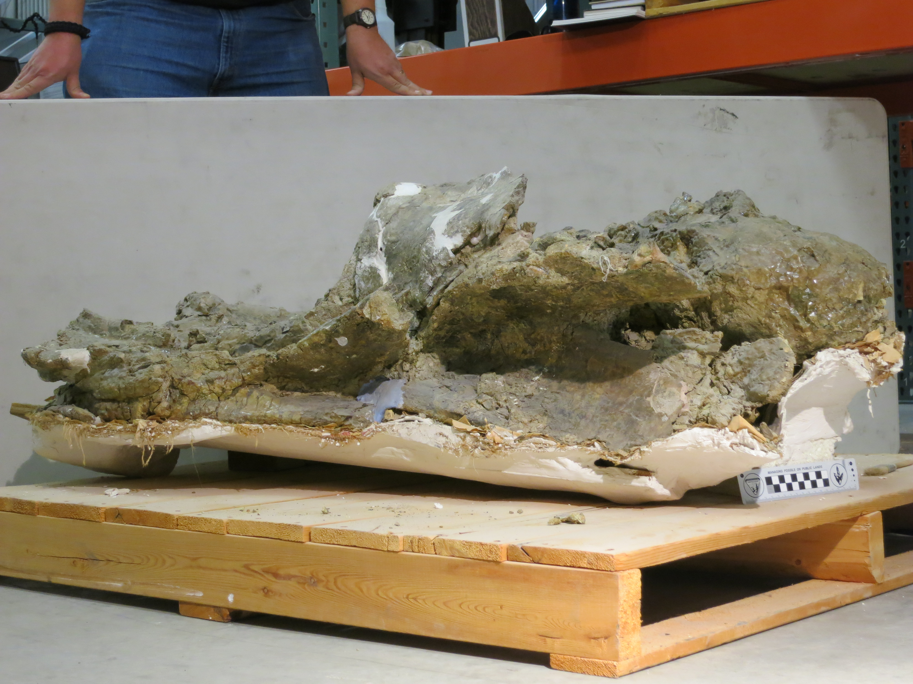
BYU 9024
“Supersaurus”
Cervical
Anterodorsal,
anterior to
right.
We think
it's Barosaurus!

Slide 65
BYU 9024
“Supersaurus”
Cervical
Anterodorsal,
anterior to
right.
We think
it's Barosaurus!

Slide 66
BYU 9024
“Supersaurus”
Cervical
Anterodorsal,
anterior to
right.
We think
it's Barosaurus!

Slide 67
BYU 9024
“Supersaurus”
Cervical
Anterodorsal,
anterior to
right.
We think
it's Barosaurus!

Slide 68
BYU 9024
“Supersaurus”
Cervical
Anterodorsal,
anterior to
right.
We think
it's Barosaurus!

Slide 69
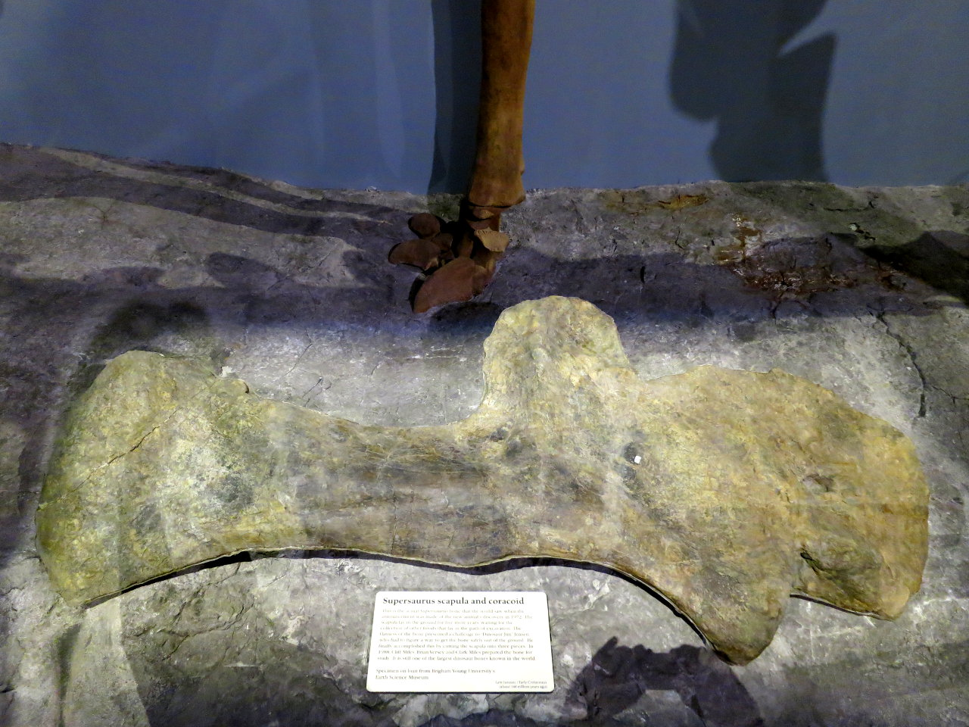
Does this
mean that
Supersaurus
is Barosaurus?
No, it's not
that easy.

Slide 70
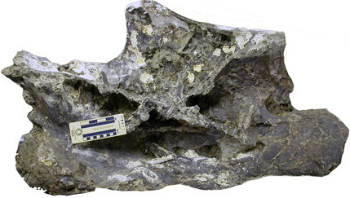
And by the way …
I don't think the Wyoming “Supersaurus” is Barosaurus.

Slide 71
Probably C9, based on
neural spine bifurcation

Slide 72
Probably C9, based on
neural spine bifurcation
AMNH C9 centrum:
685 mm
“Supersaurus” centrum:
1370 mm
Exactly twice as long!

Slide 73
Based on 8.5 m for AMNH, suggests a neck 17 m long
AMNH 6341
}
Range for
BYU 3GR
“Supersaurus”

Slide 74
What does a double-sized Barosaurus neck look like?

Slide 75
What does a double-sized Barosaurus neck look like?

Slide 76
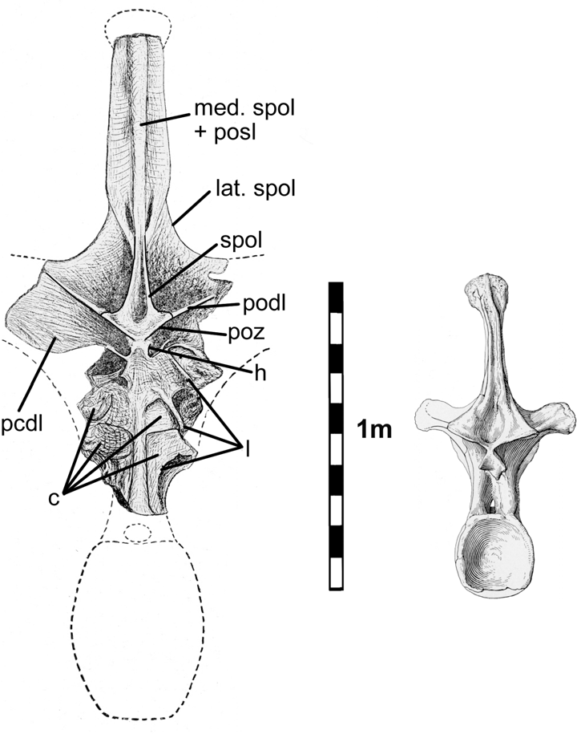
The “Supersaurus” cervical is
from a double-sized Barosaurus.
That might sound familiar.
“Amphicoelias fragillimus”
is an apocryphal double-sized
Diplodocus.

Slide 77
What does a double-sized Diplodocus look like?

Slide 78
What does a double-sized Diplodocus look like?

Slide 79
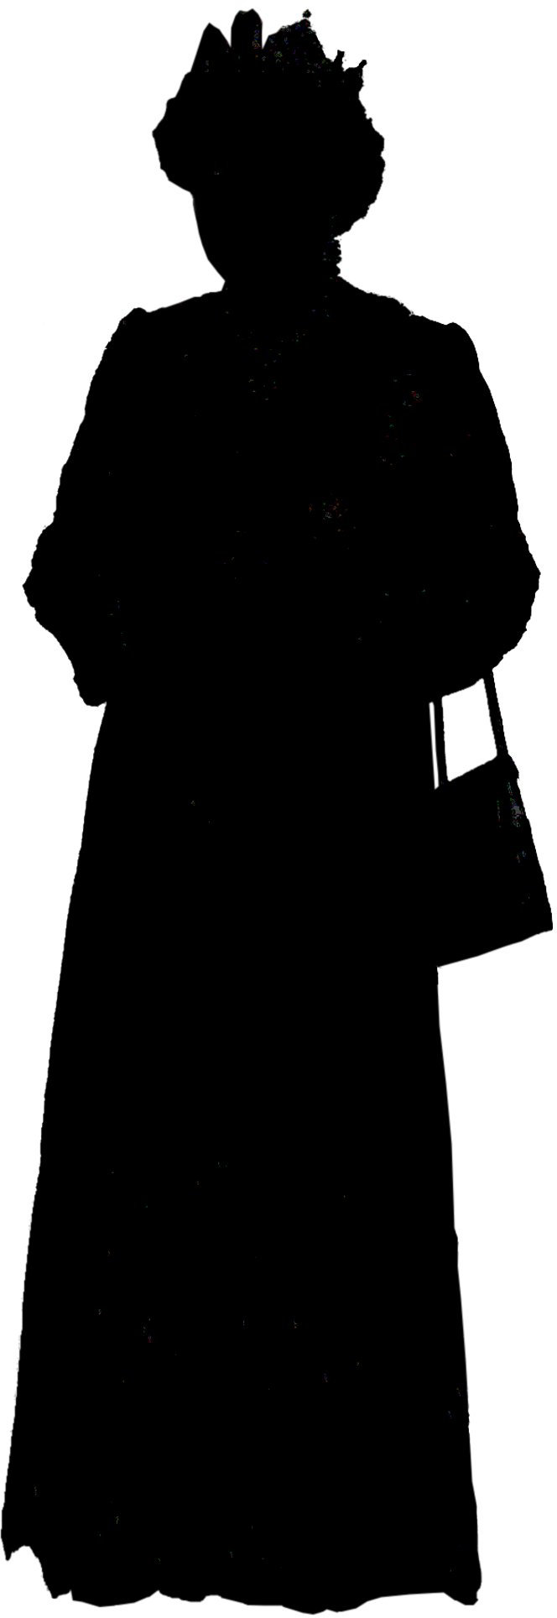
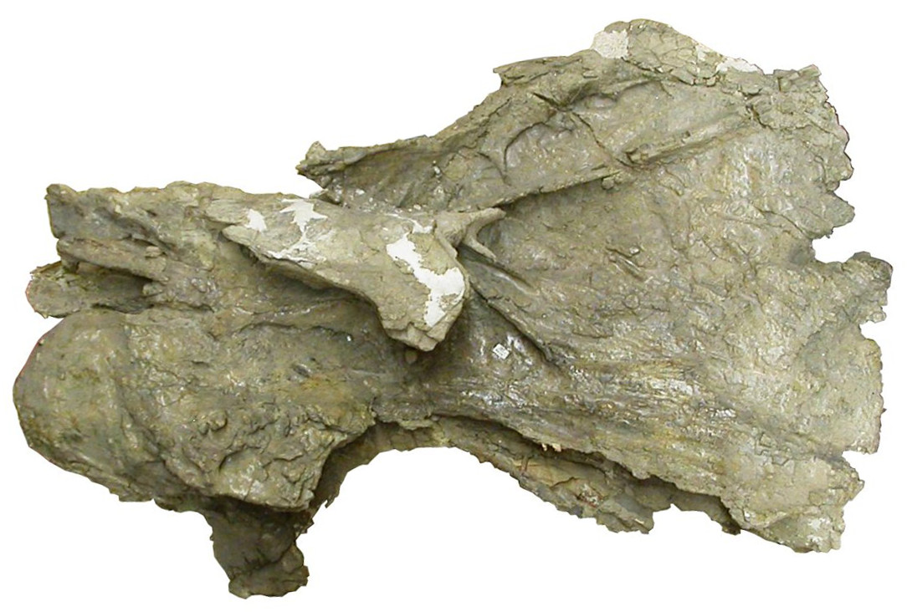
Conclusion: sauropods got really big.
“Supersaurus”: double-sized Barosaurus.
Amphicoelias fragillimus:
double-sized Diplodocus.

Slide 80
Acknowledgements
Thanks to Brooks Britt for access to BYU collections.
Rick Hunter for access to
Western Paleo's Barosaurus
material.
Dan Brinkman for access
to Yale's Barosaurus holotype.

Slide 81
How big did Barosaurus get?
Michael P. Taylor
University of Bristol, UK.
dino@miketaylor.org.uk
Mathew J. Wedel
Western University of
Health Sciences
Pomona, California, USA.
mathew.wedel@gmail.com
Art by John Conway.
✓

Slide 83
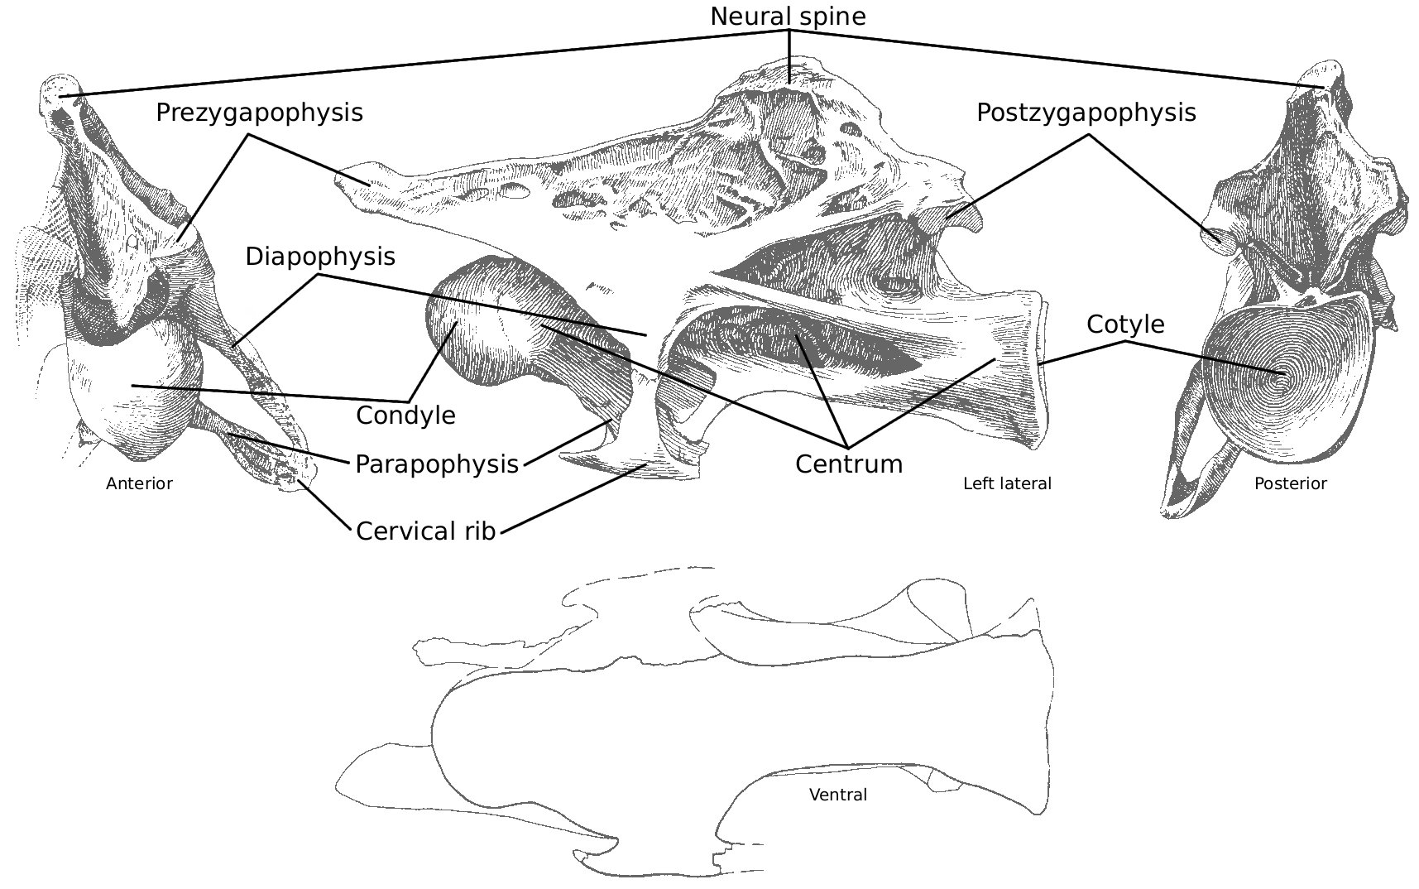
Basic anatomy of sauropod cervical vertebrae

Slide 84
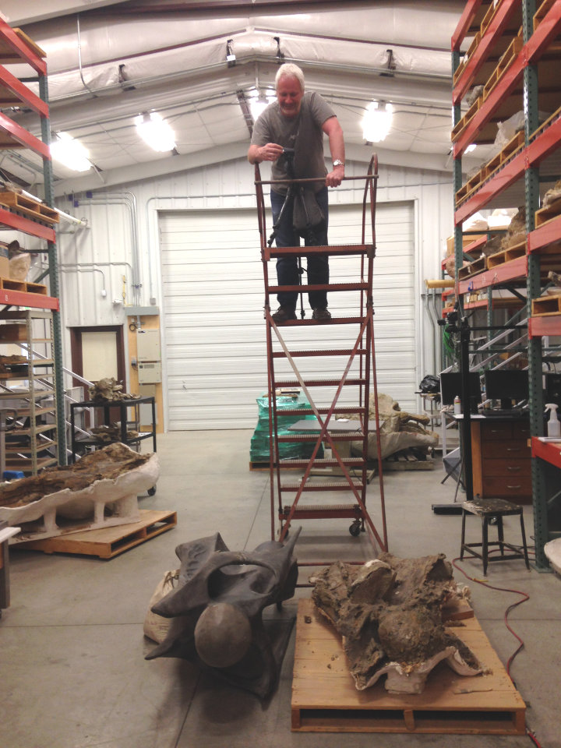
BYU 9024 “Supersaurus” Cervical
It's not easy photographing
a bone this size.

Slide 85
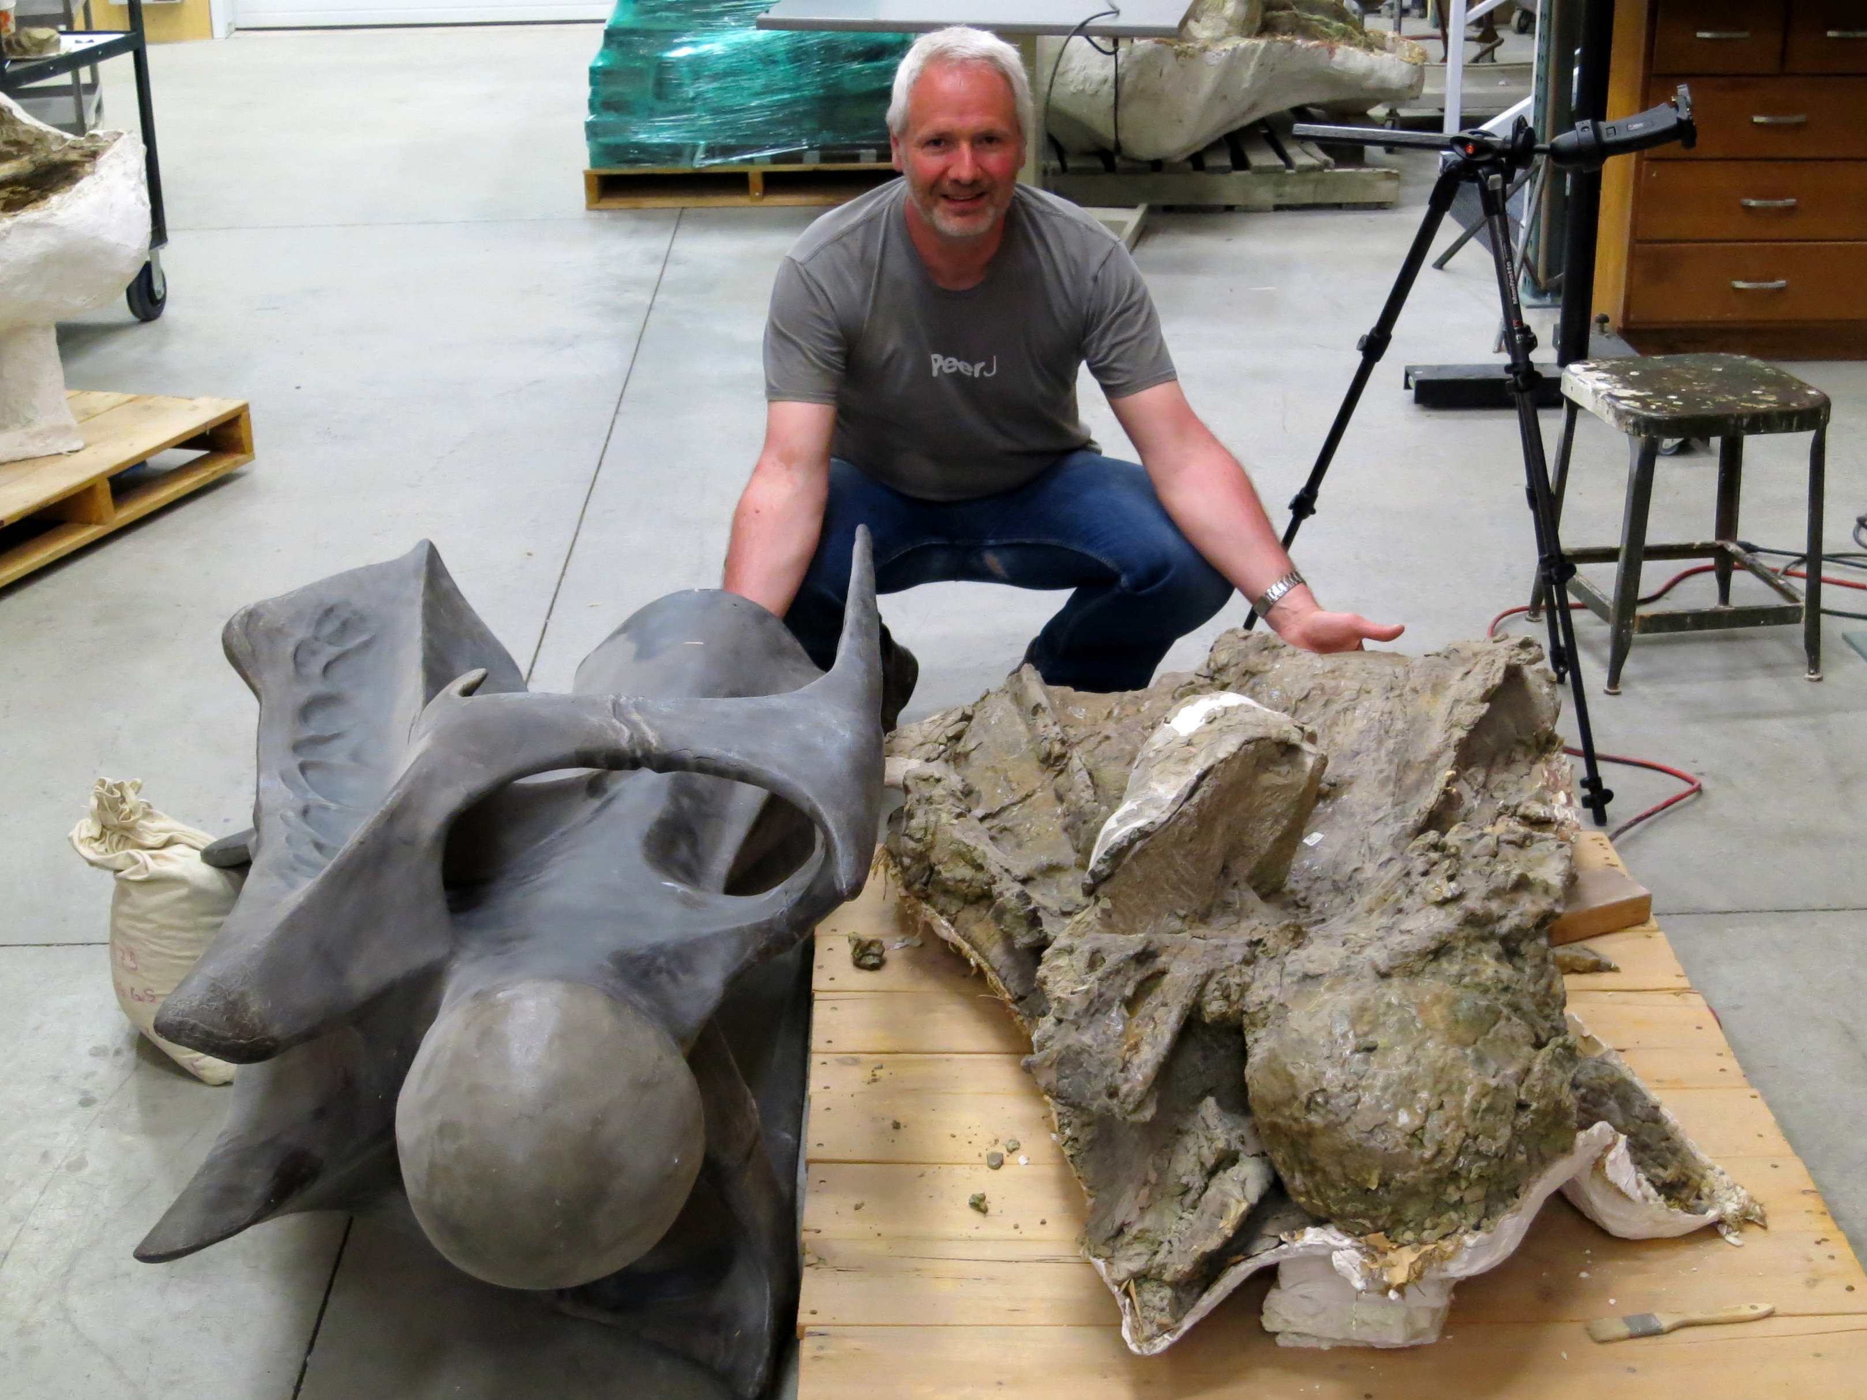
BYU 9024
“Supersaurus”
Cervical
Jim Jensen's
model of the
undistorted
vertebra.
Actually,
really good.

Slide 86
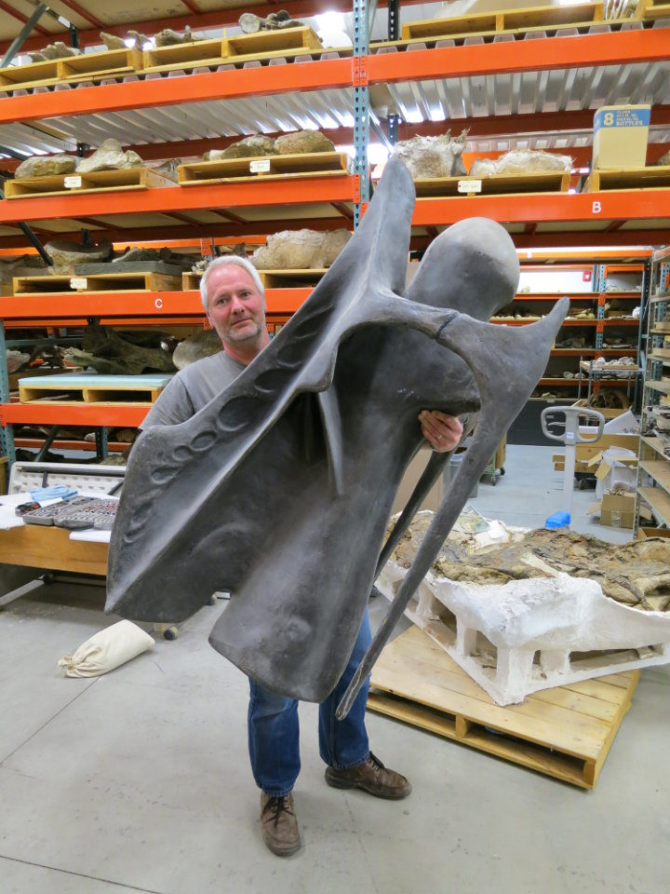
BYU 9024
“Supersaurus”
Cervical
Jim Jensen's
model of the
undistorted
vertebra.
Actually,
really good.

Slide 87
BYU 9024
“Supersaurus”
Cervical
Left lateral.
Postzyg facet.

Slide 88
Bruhathkayosaurus: the world's biggest titanosaur?

Slide 89
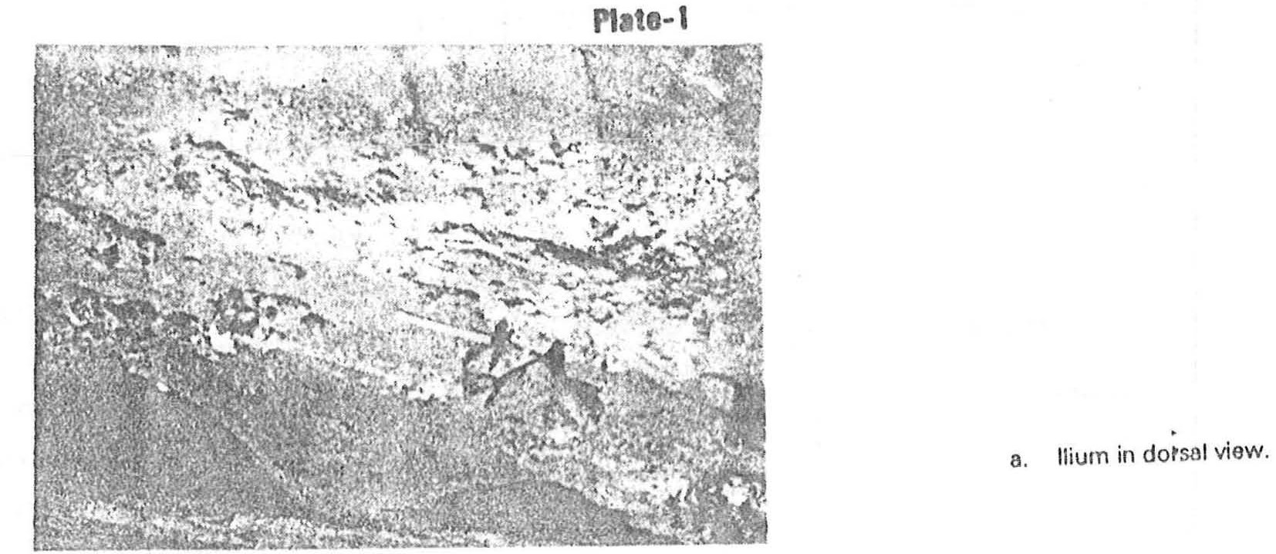
Bruhathkayosaurus: the world's biggest titanosaur?
Yadagiri and Ayyasami 1989.

Slide 90
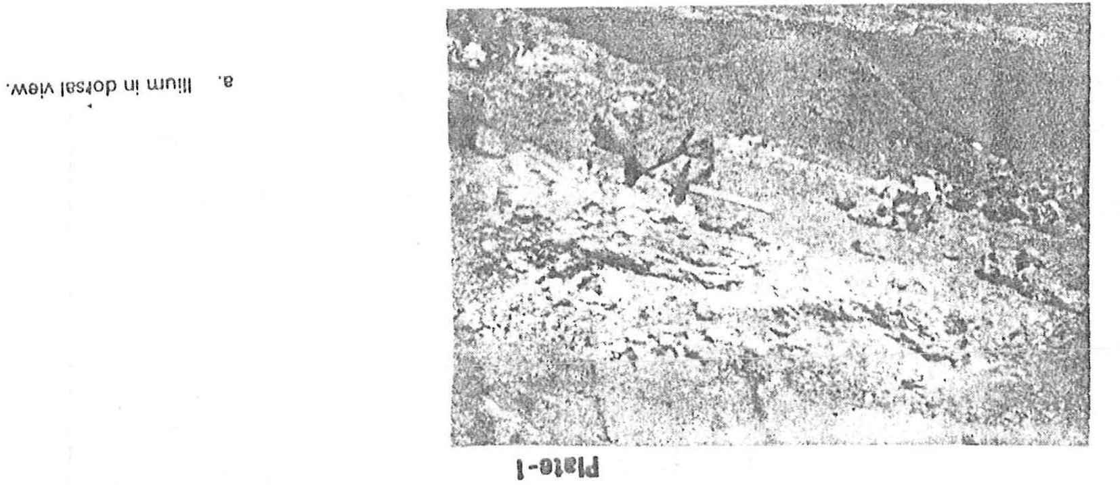
Bruhathkayosaurus: the world's biggest titanosaur?
Yadagiri and Ayyasami 1989.

Slide 91
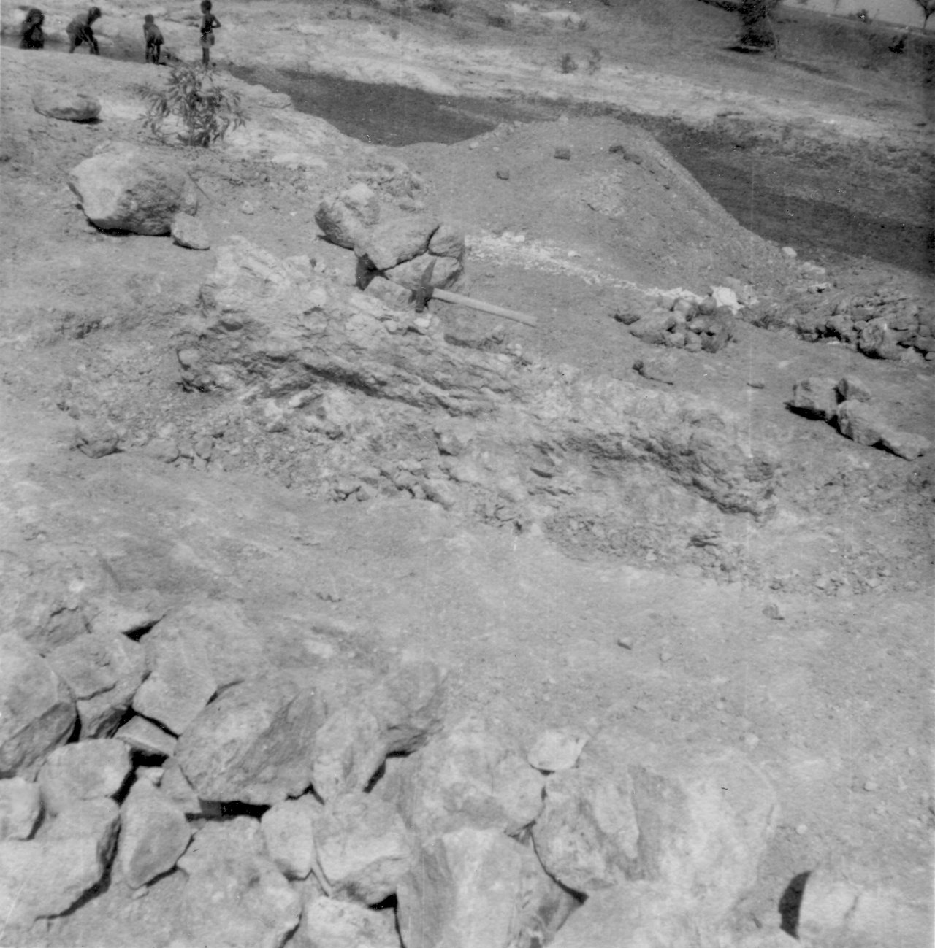
Bruhathkayosaurus: the
world's biggest titanosaur?

Slide 92
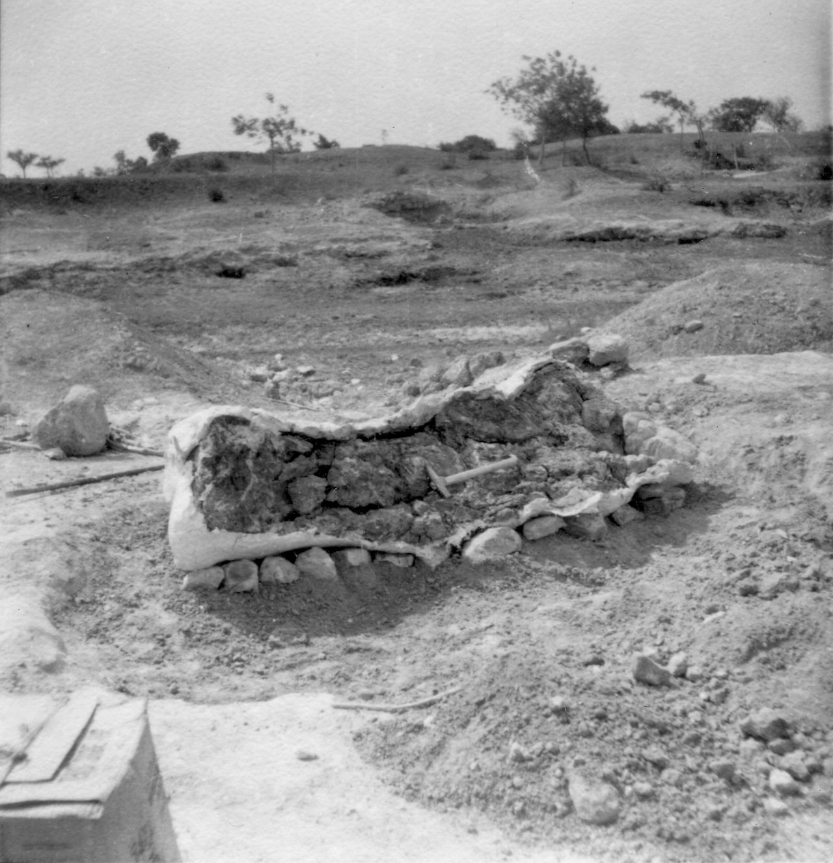
Bruhathkayosaurus: the
world's biggest titanosaur?

Slide 93
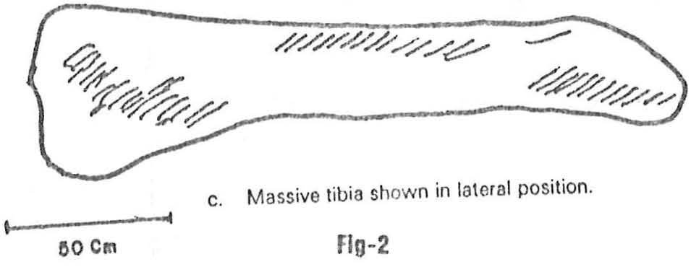
Bruhathkayosaurus: the world's biggest titanosaur?

Slide 94
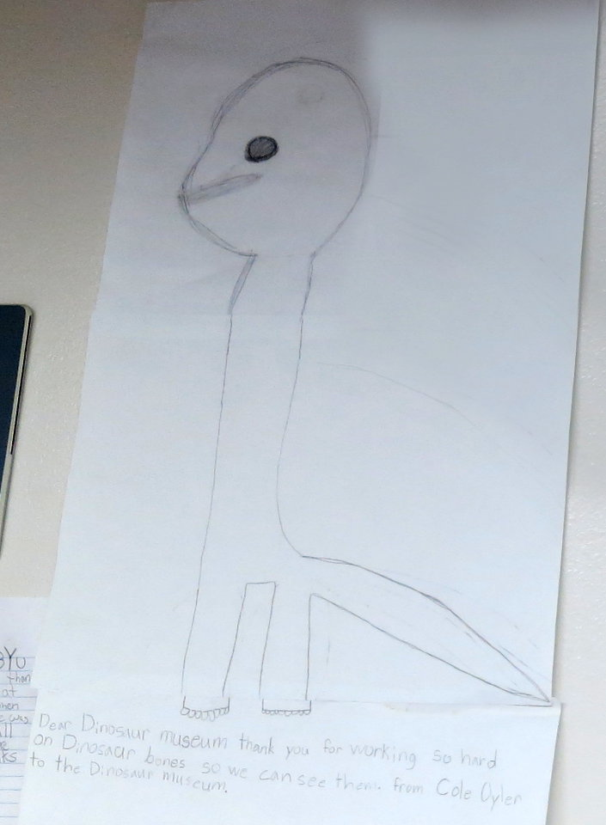
Bruhathkayosaurus:
Actual life restoration.
(Found on the wall at BYU.)
Art by Bob Nicholls.

Slide 95
Bruhathkayosaurus: the world's biggest titanosaur?
Bruhathkayosaurus tibia: 200 cm
Argentinosaurus tibia: 155 cm
(based on 155 cm fibula)
200/155 = 1.29 × longer
If isometrically similar,
1.29³ = 2.15 × more massive
If Argentinosaurus massed 73 tonnes (Mazzetta et al. 2004)
Bruhathkayosaurus may have massed 2.15 × 73 = 147 tonnes

